Slide 1
Team Exuberance
CQ WPX SSB 2019 @ K3LR
Tim Duffy, K3LR and Marty Sullaway, NN1C
K3LR@K3LR.COM, NN1C@ARRL.NET

Slide 2
The Goal: Operate CQ WPX SSB M/2 Category - Do Well!
"Old age and treachery will always win over youth and exuberance." But is that true? Team Exuberance is out to prove that statement wrong!
Can kids really do well in radiosport contesting?

Slide 3
How did this happen?
KM4ATT asks K3LR, “I have an idea!”
Team sets out to create an all-youth contest.
M/2 in CQ WPX SSB 2019
Raised money with a GoFundMe to ensure that the project was accessible to all independent of financial ability.
Costs include flights, hotels, and other logistical hosting expenses.
Amazing host. Without the kindness, generosity, and hard work of Tim, K3LR, this event would have never been possible.

Slide 4
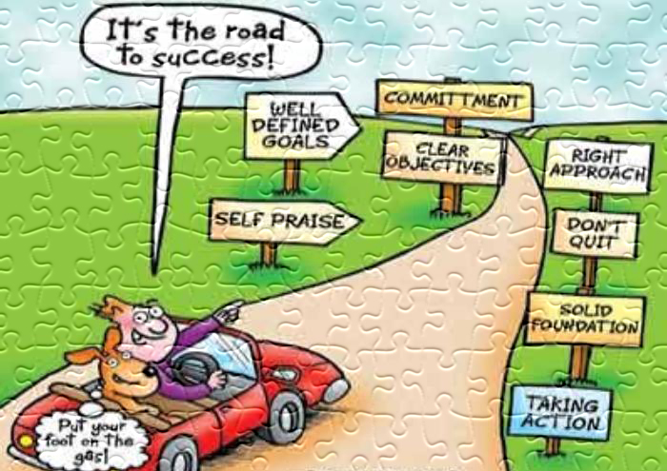
Elements of Success
Strong core team
Excellent station
Diligent planning

Slide 5
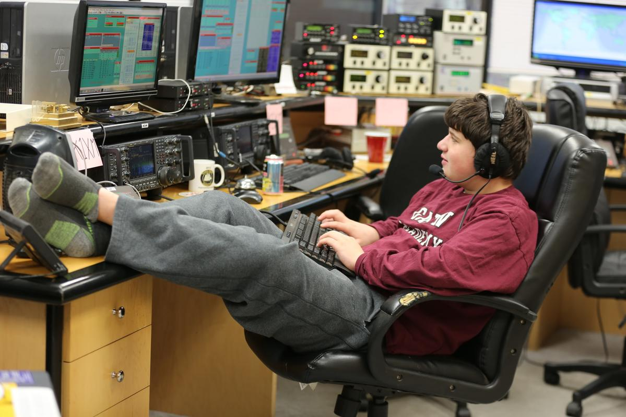
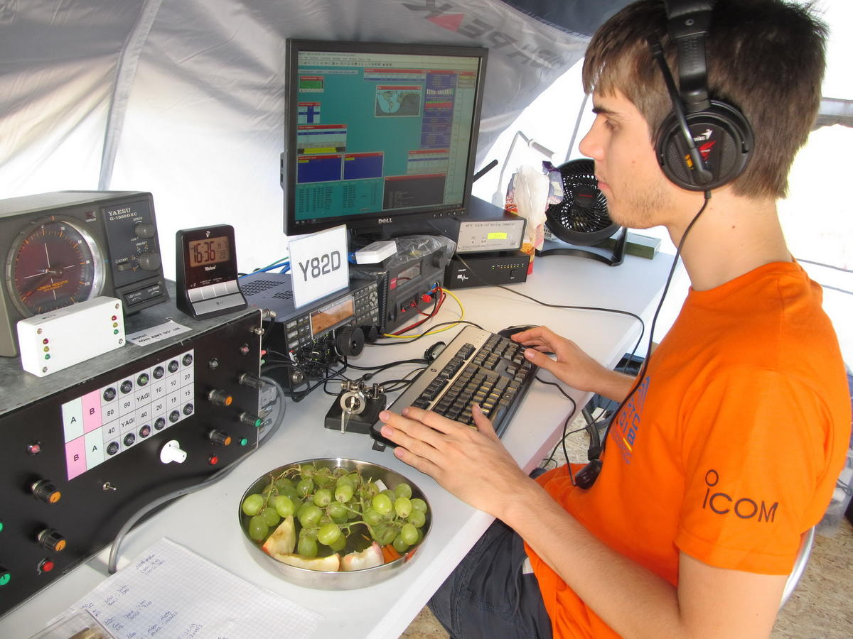
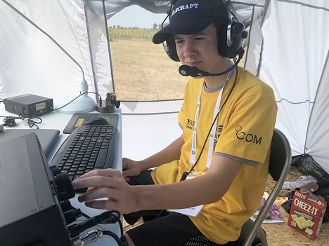
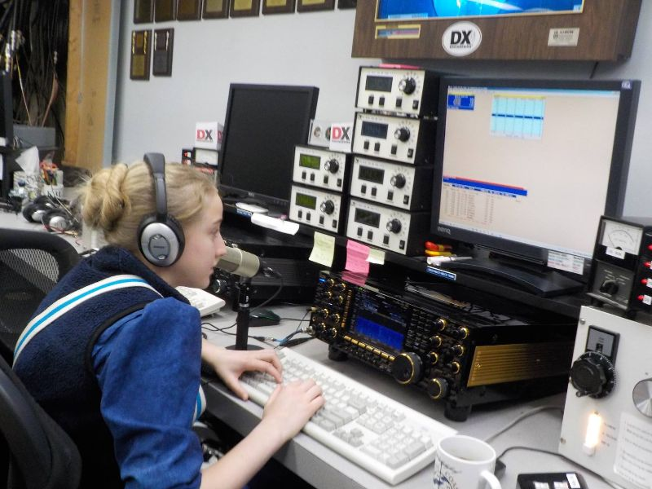
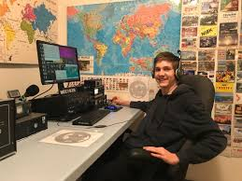

Slide 6
Tomi Varro, HA9T
Tomi was licenced in mid 2012. Tomi’s first love is CW contesting, and operating, and has been fortunate to have the chance to operate from many large contest stations in Europe. Tomi is a HST (High Speed Telegraphy) competitor, and competitor in WRTC 2018, where he was a member of Youth Team #3 along with DK6SP, and finished in the middle of the pack. Tomi loves mixed mode contesting, and has done multi-operator contests many times. Outside of radio, Tomi is a university student and programming engineer at a software company. Tomi frequents HG8DX, LX7I, and has operated from 9A1A.

Slide 7
Bryant Rascoll, KG5HVO
Bryant is a 15 year old ham that was the reigning winner of the Bill Pasternak, WA6ITF memorial Amateur Radio Newsline Youth Ham of the Year award. Bryant is a member of the Montgomery, Alabama Amateur Radio Club, the Alabama Contest Group, the Georgia Contest Group, and CWOps just to name a few. He was a participant in the World Radiosport Team Championships last summer in Germany. He also was a member of the 2017 Dave Kalter Youth DX Adventure to Costa Rica. Bryant is a frequent operator at WW4LL.

Slide 8
David Samu, VE7DZO
David, age 15, is an avid CW contester and DXer. Most active in CW, David is often found in major contests and pileups trying to work a rare DX entity. Licensed in December 2017, he has already managed to work over 185 DXCC entities and has logged over 15,000 QSOs. Collecting QSL cards from all over the world is another aspect of amateur radio that David really enjoys. His future plans and goals for amateur radio include contesting, DXpeditions, and participating in WRTC.

Slide 9
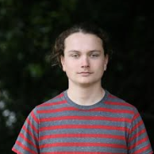
Levi, K6JO
Levi was licensed at age 14 as KK6NON, due to the generosity of his elmer, W6MFJ. After learning the ropes at W6MFJ, Levi has become a frequent operator at the NX6T superstation in Southern California. Levi has been fortunate to operate outside of the US, most recently as ZF1A, with N6MJ and K6AM and crew in the CQWW SSB and ARRL DX SSB contests.

Slide 10
Violetta, KM4ATT
Violetta was introduced introduced to the hobby at age 9 by her dad, Shannon , KA8JRQ and within a year, Violetta had earned her Extra class license. Violetta’s radio related passions include DXing, contesting, and hands-on science. Violetta has been privileged to operate with the W3LPL M/M team, and is engrossed in HF contesting!

Slide 11
Marty, NN1C
Marty Sullaway, NN1C (formerly KC1CWF) is a 17-year-old Extra Class radiosport aficionado living in Eastern Massachusetts. He is active in most major US and domestic radiosport events. While he has a modest station at home consisting of various wire antennas, he has had the opportunity to pilot many larger contests stations. Marty enjoys SO2R as well as multi-op contest entries. In recent years, Marty has found himself operating at stations such as K1LZ, K1VR, K1IR, 4X6TT, HH2AA, K6ND, and K1TTT in some of the major DX contests.
Marty has been fortunate to be a member of winning teams, having won both modes of CQ WW and ARRL DX contests in M/S and M/2 categories, and was deeply honored to be selected as the 2017 Bill Pasternak, WA6ITF memorial Amateur Radio Newsline Youth Ham of the Year award.

Slide 12
K3LR 2019 WPX SSB Team
Operators: NN1C, HA9T, VE7DZO, K6JO, KG5HVO, KM4ATT
A combined 10+ contest wins.
Two WRTC 2018 competitors
Operators from prominent stations around the world: ZF1A, W3LPL, K1LZ, WW4LL, VE7SV, HG8DX, LX7I, NX6T, K6AM, 4X6TT, 9A1A
Average age ~ 16.

Slide 13
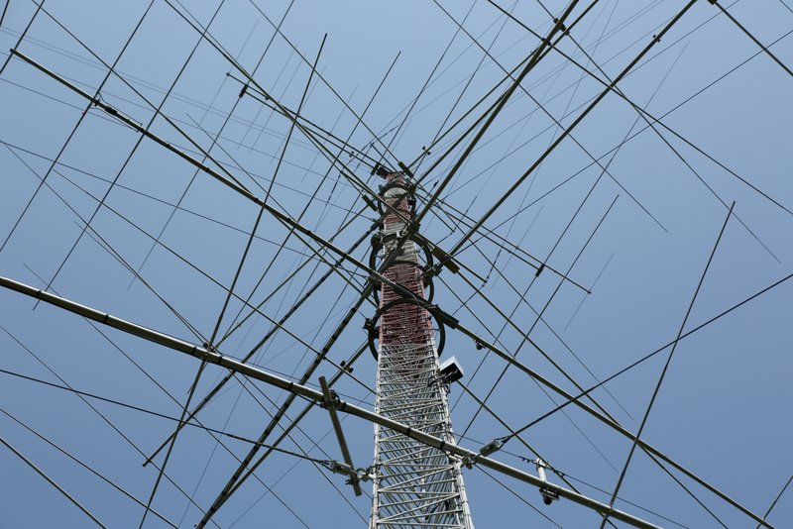
K3LR Superstation
11 Operating positions
26 Booms
164 Transmitting elements
Miles of coax
11 Homebrew 8877 1500w amps.
13 IC7851/IC7850 radios.
Lots of coffee!

Slide 14
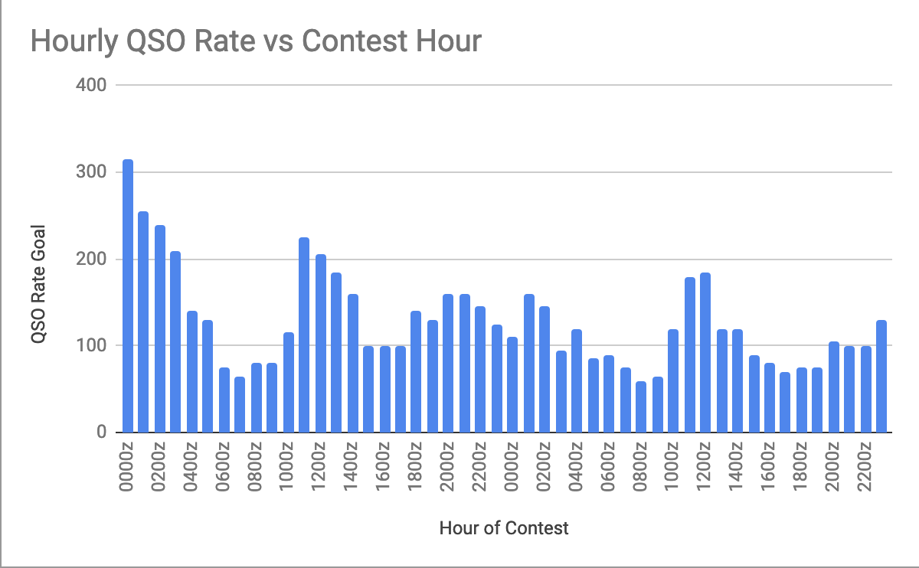
Planning!
No competitive contest effort is complete without planning and organization.
Many spreadsheets!
Operator schedules, rate goal sheets, travel logistics, sleep schedules, team handbooks, propagation analysis, must be generated.
Lots of mentor consultation
Hourly QSO Goals: Analytics are important for success!

Slide 15
This Is Only The Start!
We believe we are the first all youth serious contest operation in North America.
Hope to be the first, not last!
YARC YCP program (yarc.org) to continue the trend.
Youth are the future.

Slide 16
Thanks To Some Amazing People!
Tim, K3LR, Tim, W3YQ, Dan, N6MJ, and Teri, K8MNJ, along with the rest of the DX Engineering team.
Operators: K6JO, VE7DZO, KM4ATT, HA9T, KG5HVO
All of the elmers and mentors that have made this possible.

