Slide 1
Comparison of Vertical Arrays for Low Band Receiving
Joel Harrison, W5ZN

Slide 2
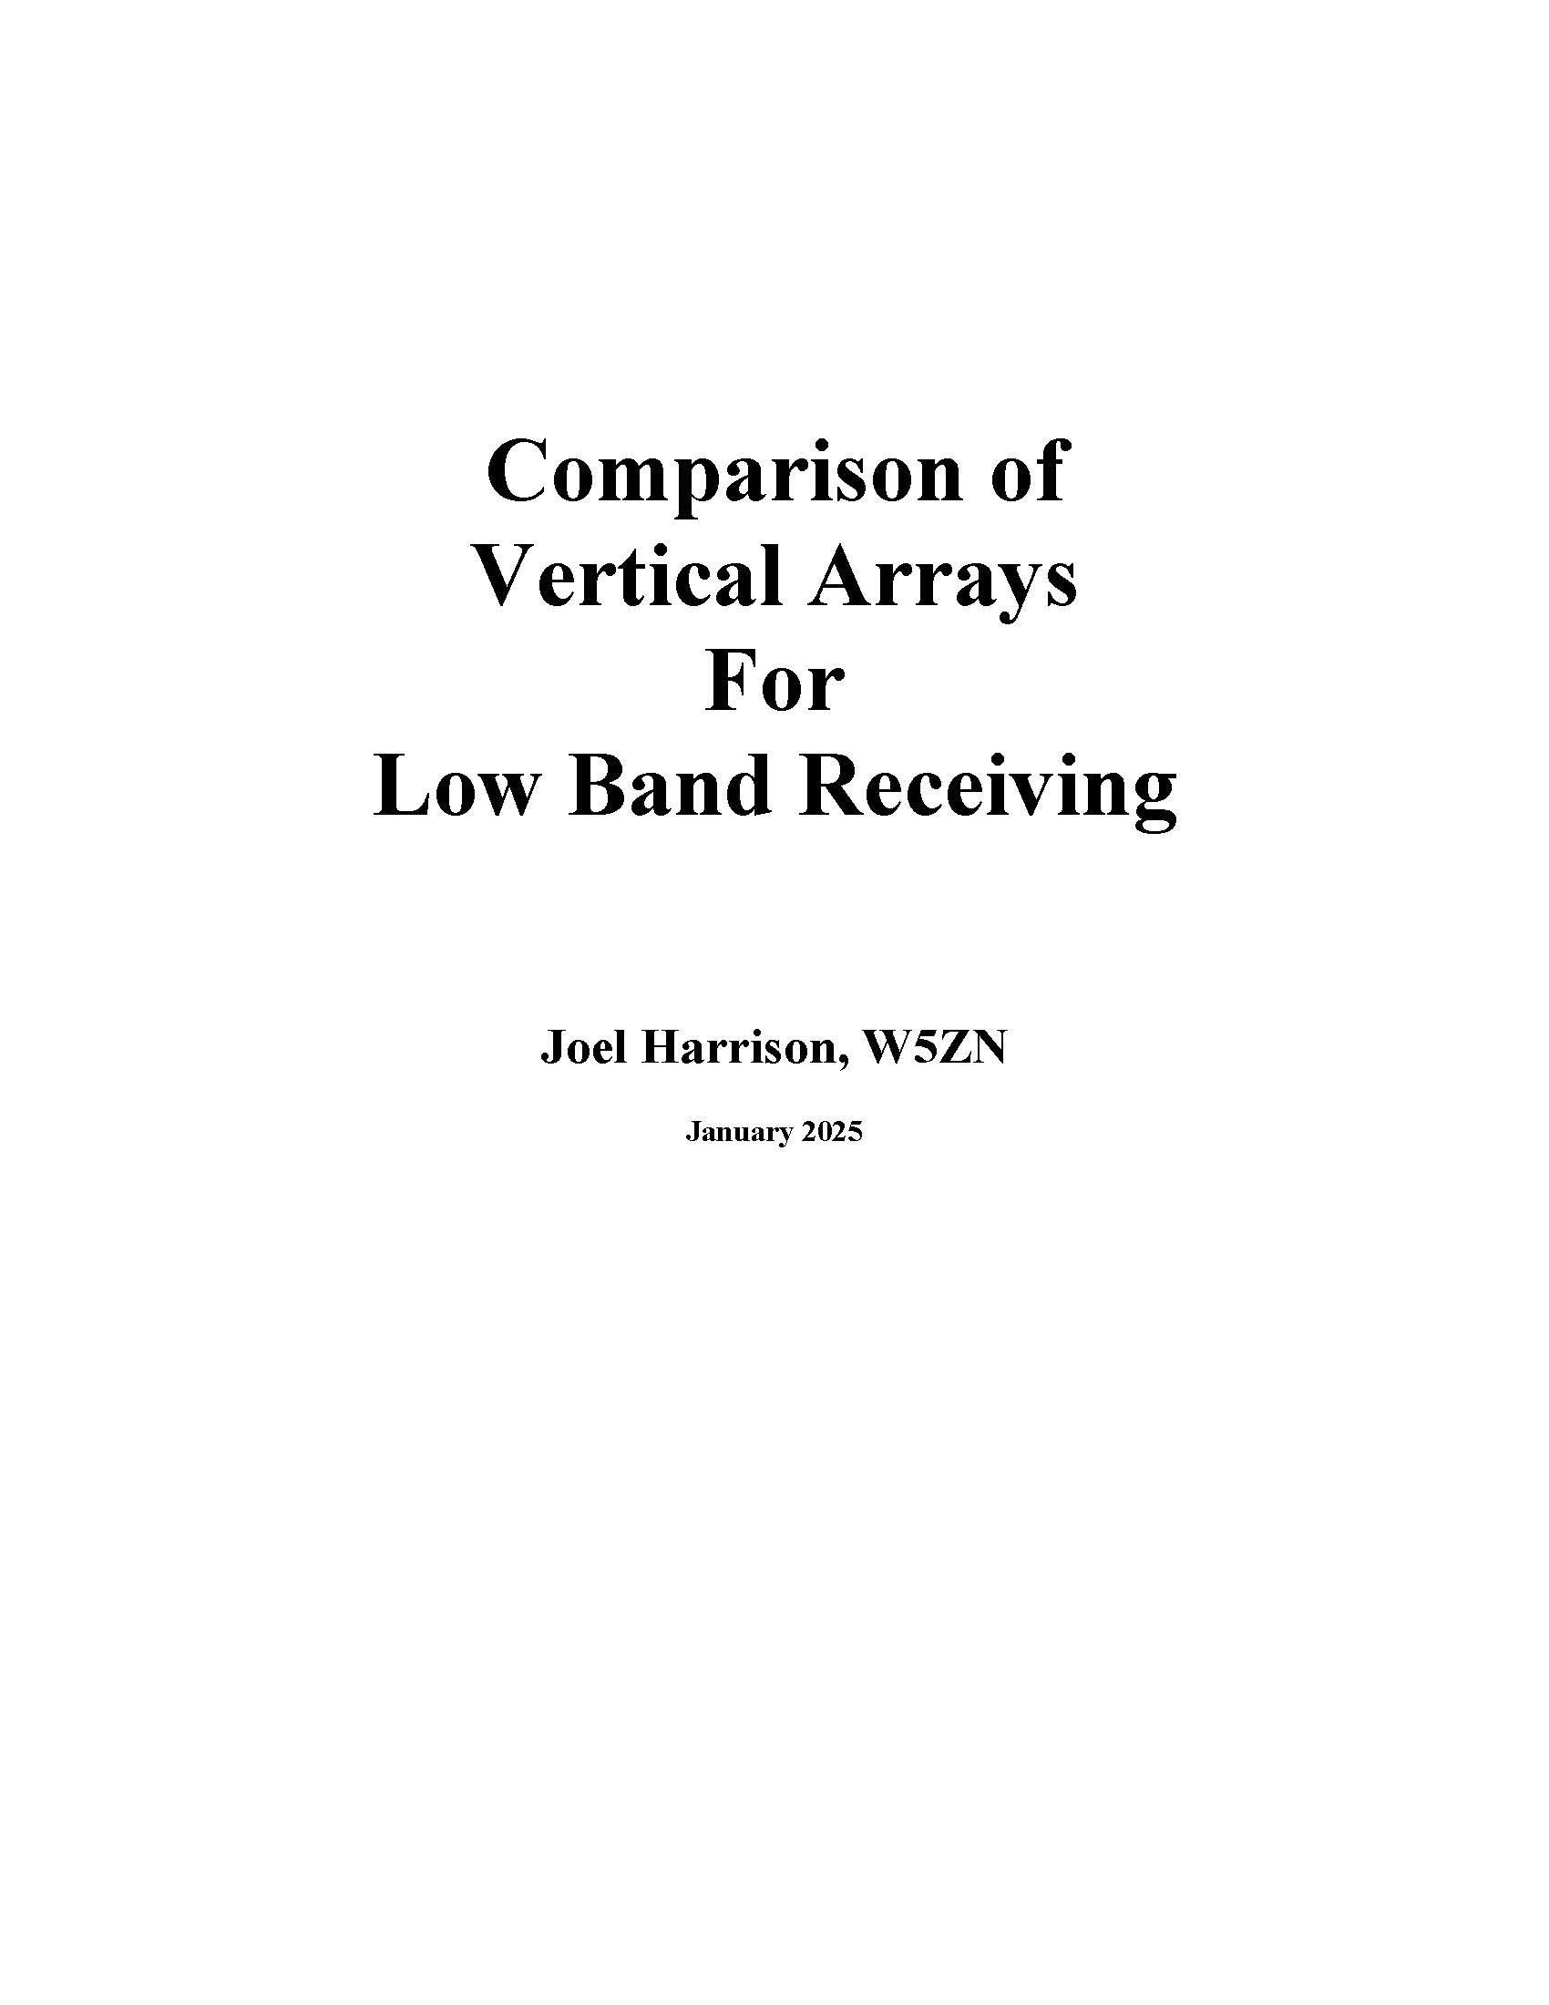
What We’ll Cover
Low band propagation
History of my experience with vertical arrays
Different types of vertical array
Approach to comparing low band receive antennas
Test Equipment & Calibration
Data Collection
Results
www.w5zn.org

Slide 3
Propagation
Geographical differences matter when comparing antennas
Comparing one antenna in a location 1,000 miles away on the east coast with a similar antenna located in rural Arkansas will not give an accurate comparison
  The exact same antenna may actually perform differently in these two locations for a variety of reasons

Slide 4
Propagation
I compare 160-meter signals with:
  W0FLS in Iowa is 425 miles north at 344°
  W5UN in northeast Texas is 200 miles SW at 235°
  K5RK in south Texas is 450 miles S/SW at 205°
  The propagation differences of what we each can and cannot hear is at times significant!
Close to home:
  K5UR is 25 miles southwest
  WD5R is 20 miles north/northwest
  K5EJ is 25 miles north
  We compare notes frequently and the difference between signal-to-noise ratios for the three of us this close is sometimes eye opening

Slide 5
Propagation
160-meter propagation is beyond the scope of this presentation however, I encourage you to read the excellent work by Carl Luetzelschwab, K9LA, and Frank Donovan, W3LPL, on this topic
Carl’s info can be found at http://www.k9la.us/html/160m.html

Slide 6
The Quest for the Optimum Receive Antenna
For years I experimented with Beverage and loop antennas
  Worked well but kept seeking improvement
2008 N4HY told me about a broad side-end fire (BSEF) array
  Performance exceeded Beverages and loops
K7TJR’s HiZ-8 vertical array
W1FV 9 Circle Array

Slide 7
Differences in Vertical Arrays
There are differences in vertical arrays arranged in a circle and the difference must be understood
Dayton Conversation a few years ago:
  I’m putting up an 8 circle array”
  “Great, which One?”
  “The one with 9 verticals”
What we’ll discuss today are the three most popular vertical arrays arranged in a circle to achieve 8 directional patterns

Slide 8
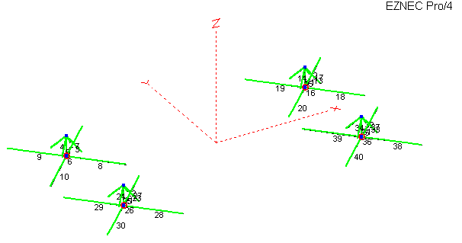
The Broad Side-End Fire (BSEF) Array
Notes:
350 ft diameter. Low impedance

Slide 9
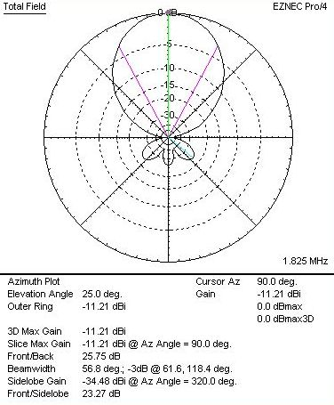
The Broad Side-End Fire (BSEF) Array
Notes:
58 deg Beamwidth, 26 db FB

Slide 10
The HiZ-8 Array
Notes:
160 meter version is a 200 ft diameter circle. High impedance with amplifiers at each element

Slide 11
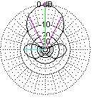
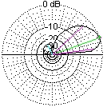
The HiZ-8 Array
Notes:
Even though there are some front to side lobes in the azimuth plot the F/B is excellent

Slide 12
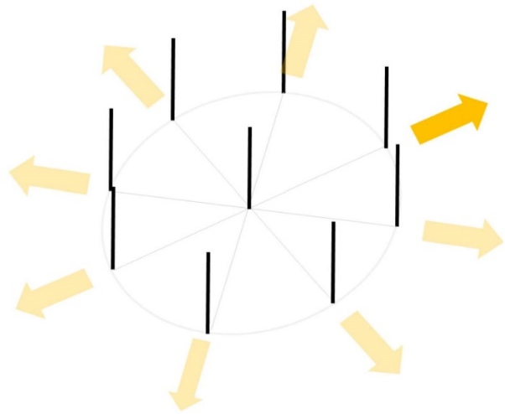
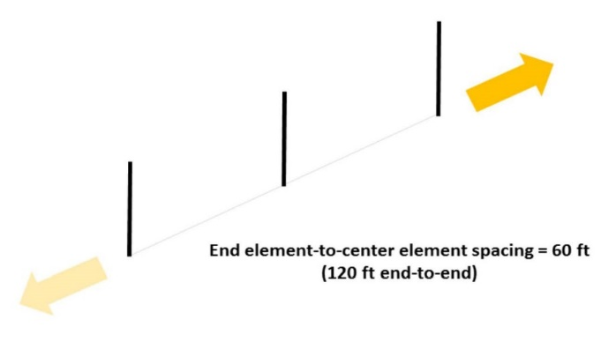
The W1FV “YCCC-9” Array
Notes:
120 ft diameter circle. High impedance with amplifiers at each element.

Slide 13
The W1FV “YCCC-9” Array
Notes:
75 deg beamwidth and an F/B of >25 dB

Slide 14
The Beverage Antenna
Introduced in 1921, the Beverage
Rightfully became the standard by which all low band receive antenna performance is evaluated against
Many books and papers published on the Beverage antenna
  “The Beverage Antenna Handbook” by Victor Misek, W1WCR, first published in 1977, provided informed guidance for many years but is no longer in publication
  “Low Band DX’ing” by John Devoldere, ON4UN was published and now regarded as the go to source for Beverage antenna instruction

Slide 15
The Benchmark Beverage
Greg Ordy, W8WWV, provided extensive details on Beverage antennas of different lengths in his paper “The Benchmark Beverage”
http://seedsolutions.com/gregordy/Amateur%20Radio/Experimentation/Beverage.htm
“For me, the Beverage represents a yardstick which can be used to compare the performance of other receive antennas” – W8WWV
To establish a performance base, a single wire 580 ft Beverage is included in my comparative analysis results

Slide 16
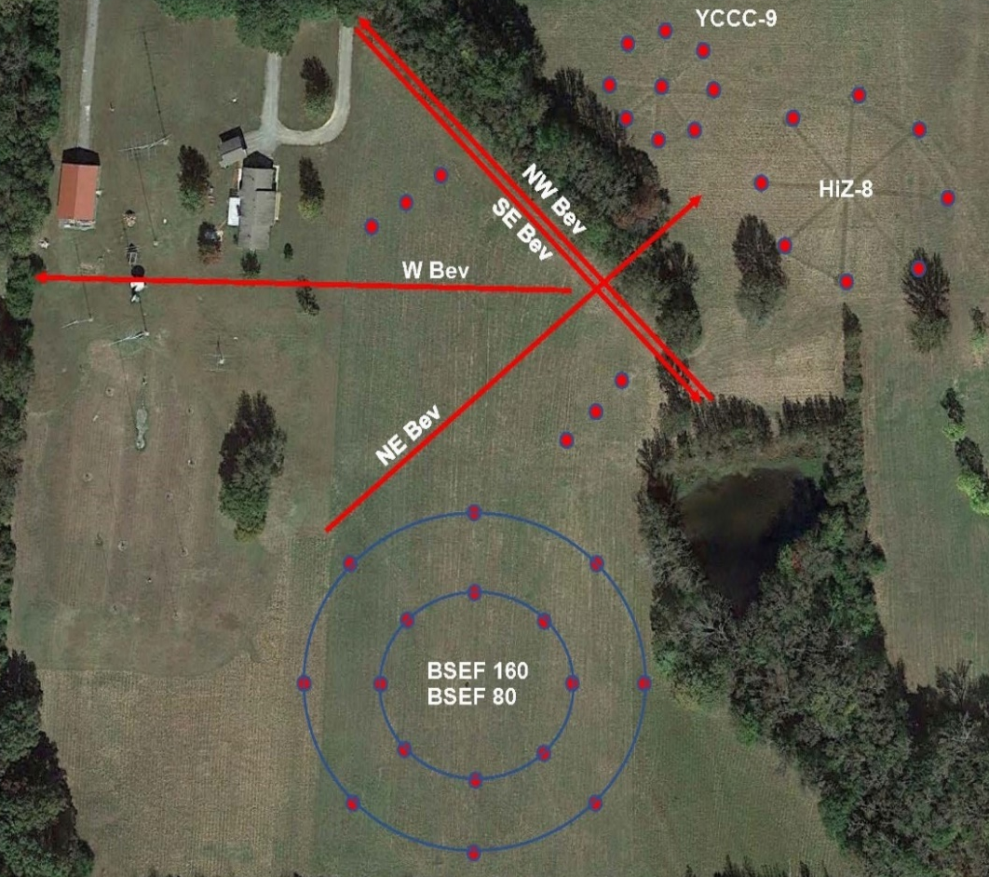
W5ZN Test Range
BSEF-8: 800 ft south of shack
HiZ-8: 750 ft east of shack
YCCC-9: 500 ft E-NE of shack
The 160 meter transmit antenna is 300 ft NW of BSEF-8, 1000 ft from HiZ-8 and YCCC-9

Slide 17
Parameters for Comparison Tests
Compare modeling & simulation results
Collect empirical data
Determine if any modeling & simulation differences from the empirical data would present real world variations that could be identified in day-to-day operation on 160

Slide 18
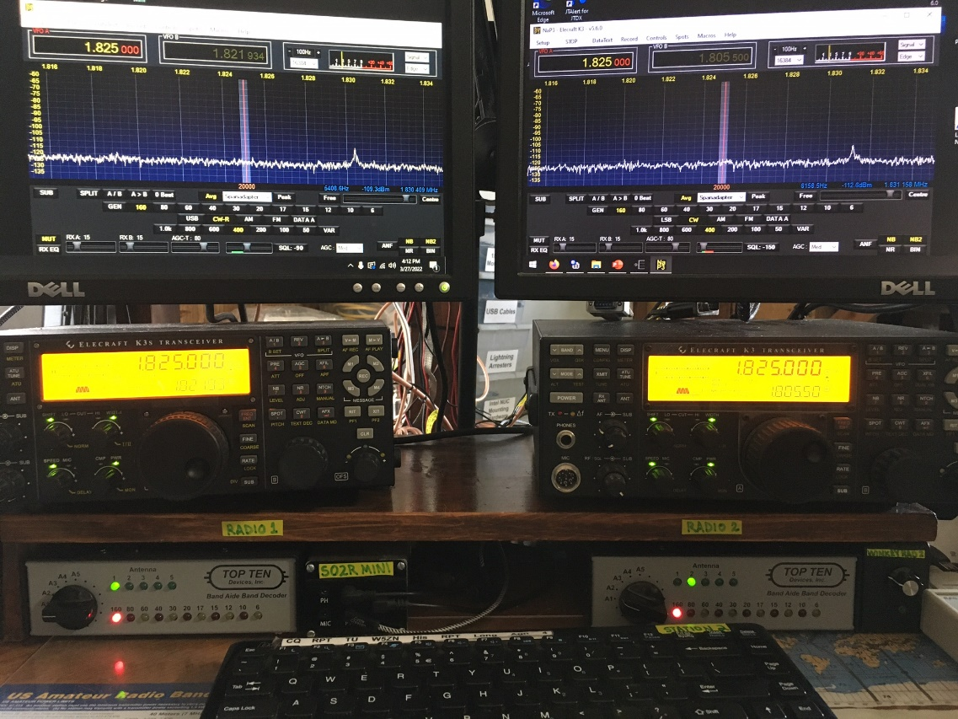
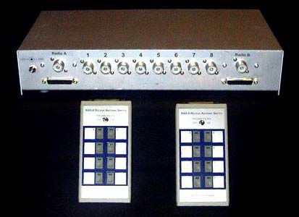
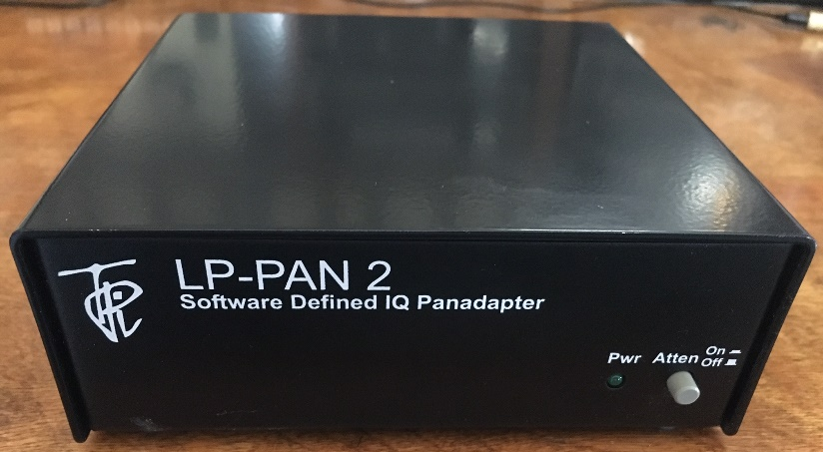
Test Equipment
Test equipment is comprised of two each of the following:
  Elecraft K3 Transceiver
  LP-PAN 2 Software Defined IQ Panadapter
  NaP3 Panadapter display software
K9AY RAS-8 Antenna Switch
  2 receiver outputs

Slide 19
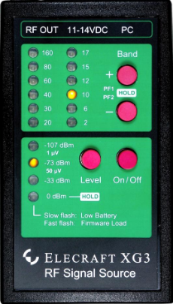
Calibration
The test equipment must be calibrated to eliminate any known variables in the measurement procedure
An Elecraft XG-3 Signal Source is used to establish and maintain a calibrated display on the NaP3 panadapter
Prior to the start of each series of measurements, a -73 dBm signal (S9) is injected into the signal cable at the array end to verify calibration

Slide 20
Calibration
Given the approximate distance of 800 ft from each array to the receiver, RG-11 75Ω coax is used for the signal cable
The measured cable loss on 1.825 MHz is 2.0 dB and verified daily prior to measurements
Having two outputs from the RAS-8 adds an additional 2.5 dB of loss
The -73 dBm signal injected at the combiner output of the array is now -77.5 dBm on the panadapter screen. This is verified during the calibration procedure and before data collection

Slide 21
Signal Measurement & Comparison
Comparing arrays requires documenting several different types of signal amplitude data in 8 directions. These include:
  the noise floor level
  forward peak
  front to back (F/B)
  front to side (F/S)
  For these measurements the panadapter display must be capable of 1 dB resolution for measurement accuracy. This cannot be performed with a radio’s S meter!
All of the signal levels were recorded in CW mode with a 400 Hz bandwidth during or near dark time hours without noise blanking or noise reduction activated

Slide 22
Signal Measurement & Comparison
The empirical data for this research was collected over a period of ten years
  The forward peak signal data was recorded from over 100 DX stations outside the USA
    A few of these were the same station but acquired during a different time of day, time of year, or time during the solar cycle.
  Since most all of the DX signals were too weak to document signal amplitude in antenna directions other than a direct path, data from approximately 30 stations in the USA was collected for pattern comparison to the model
    This was conducted with the understanding that the USA stations will present a variety of different signal arrival angles originating from different transmit antenna configurations however, the results are accurate and valid.

Slide 23
Noise Floor Measurement
Comparing the measurement of each array’s noise floor must take into consideration whether it is an active or passive system
  Any preamplifiers placed in the system will affect the noise floor of the array
The noise floor was measured and documented in each of 8 directions in 45-degree steps from north, rotating clockwise to northwest

Slide 24
Noise Floor Measurement
For the two 8 vertical arrays no preamp is used on the output of the phasing unit
  The noise floor in the shack, through 800 ft of feedline and the RAS-8 switch, averages -120 dBm
The output of the YCCC-9 is low so I do have a preamp at the output of the phasing unit as recommended in the YCCC documentation
  Through 500 ft of feedline and the RAS-8 the noise floor is -125 dBm, 5 dB less than the two 8 vertical arrays but very adequate for comparative measurements
The four Beverage antennas have a -125 dBm noise floor

Slide 25
Noise Floor Measurement
I’ve spent many days and weeks working with my local electric utility to eliminate power line noise and at least for now my location is as quiet as possible and consistent in all directions.
What is out of my control are noise sources from consumer products originating from neighboring houses. While these are annoying at times, if not overly restrictive they can be used as comparison signals!

Slide 26
Forward Peak Signal Amplitude
The forward peak signal amplitude is simply the strength of the received signal in the forward (direct) path to the originating station
  There were a couple of exceptions to this, when a station presented a maximum signal from a skewed or longer path along the gray line
The level is recorded in dBm and referenced to the noise floor
  For example, if I record a peak signal at -120 dBm with a -125 dBm noise floor, The signal is 5 dB above the noise floor

Slide 27
Forward Peak Signal Amplitude
Some of the DX stations recorded in the data include:
3B7A, 3B9HA, 3C0W, 3DA0IJ, 3V8SF, 3XY1T, 3X5A, 4W8X, 5U5R, 5V7D, 5W0UU, 5X3C, 7X7X, 7O2WX, 7Z1SJ, 9J2LA, 9K2HN, 9L5A, 9M0W, A35T, BD4WN, BU2AQ, C31CT, CB0ZA, CY9C, DU7ET, E51DWC, E77DX, ET7L, FT4JA, HL5IVL, JD1BMH, K5P, KH6AT, KL7J, OD5NJ, RA0FF, ST2AR, TF3SG, TL8TT, TU7C, V63DX, VE9AA, VK2WF, VK6HD, VP8SGI, VP8STI, XV1X, ZD8W, ZF9CW, and ZL1AZ

Slide 28
Forward Peak Signal Amplitude Results
The forward peak results reveal the HiZ-8 array provided a 1 to 2 dB increase over the BSEF-8 array on some signals while at other times the BSEF-8 would outperform the HiZ-8 by the same difference
  Often while monitoring the same station over a period of time this result would be reversed. There was no consistent difference between the two arrays in forward peak signal
The forward peak signal received with the YCCC-9 was consistently 2 to 3 dB lower than either of the 8 vertical arrays
Notes:
. As noted in Section 7.1 the noise floor for the BSEF-8 and HiZ-8 array is the same but the YCCC array’s noise floor is 5 dB lower, the same for the Beverages. When a peak signal is identified as being lower on one array versus another it is based on the level above the noise floor. For example, even though the YCCC-9 noise floor is 5 dB lower than the BSEF-8 and HiZ-8, a signal 2 dB above the noise floor is considered the same as a 2 dB signal above the noise floor on the others. I did experiment, to a limited extent, with adding some external preamplification gain to bring the noise floor of the YCCC-9 and Beverage antennas up to the same -120 dBm level of the BSEF-8 and HiZ-8. This did not, in any of the situations investigated, increase the peak signal to a greater level above the noise floor than originally documented.

Slide 29
Forward Peak Signal Amplitude Results
The forward peak signal on the 580 ft Beverage antennas was consistently 3 dB lower than the BSEF-8 and HiZ-8 arrays and equivalent to or around 1 dB lower than the YCCC-9
There were times when the vertical arrays recovered more quickly from deep fades than the Beverage.
  This was not due to the increased gain or signal level of the vertical arrays over the Beverage because at times the vertical array signal would reappear out of the noise at a high enough amplitude that the Beverage should have revealed the signal
Notes:
. As noted in Section 7.1 the noise floor for the BSEF-8 and HiZ-8 array is the same but the YCCC array’s noise floor is 5 dB lower, the same for the Beverages. When a peak signal is identified as being lower on one array versus another it is based on the level above the noise floor. For example, even though the YCCC-9 noise floor is 5 dB lower than the BSEF-8 and HiZ-8, a signal 2 dB above the noise floor is considered the same as a 2 dB signal above the noise floor on the others. I did experiment, to a limited extent, with adding some external preamplification gain to bring the noise floor of the YCCC-9 and Beverage antennas up to the same -120 dBm level of the BSEF-8 and HiZ-8. This did not, in any of the situations investigated, increase the peak signal to a greater level above the noise floor than originally documented.

Slide 30
Forward Peak Signal Amplitude Results
Simple line graph depicting the forward signal level comparison of the four receive antennas

Slide 31
Front to Back & Front to Side Comparison
The HiZ-8 exhibited a solid 25 to 30 dB F/B repeatedly when comparing multiple signals
The BSEF-8 array exhibited an F/B of between 20 to 25 dB
The YCCC-9 F/B is exceptional and in line with the HiZ-8 at 25 to 30 dB
  Given the design uses three in line verticals that should afford a significant F/B, this was expected
The 580 ft Beverage’s averaged ~20 dB F/B and an F/S equivalent to that of the YCCC-9
Notes:
Hiz-8 If a signal could be placed exactly in a side or rear null, reductions greater than 30 dB were easily achieved.
BSEF - Some of the side nulls were 2 to 3 dB better than the HiZ-8 however, when rotating away from the main lobe beginning 45° from the peak clockwise to the point 45° just prior to returning to the forward direction the HiZ-8 provided a much sharper pattern and better overall rejection. Even though the BSEF-8 had a few instances of better side lobe performance, I was unable to obtain a reduction more than 25 dB at any point.
YCCC - It does not however, provide the F/S rejection seen with either the HiZ-8 or the BSEF-8. This is also expected given the broad forward pattern isn’t as sharp as the other two vertical arrays.

Slide 32
Modeling Versus Actual Field Measurements
Receiving Directivity Factor (RDF)
  the ratio of the forward gain at a desired direction and take off angle to the average gain over the rest of the entire hemisphere around the antenna
  has become one of the standards for evaluating low band receive antennas
  Some of the early work in defining RDF is documented by Bill Hohnstein, K0HA
  Most noise sources will have a direct azimuth location but may also be present over a wide range of areas surrounding the antenna’s pattern in both azimuth and elevation, thus the importance of considering RDF.
  Maximum rejection off the back and side of an array will only be achieved if the arrival angle of an undesired signal appears in the deepest position of the null
Notes:
Bill had initiated several threads on the Top Band Reflector that became the groundwork for RDF. An in-depth discussion of RDF is not germane to this paper however, I encourage you to review this early work contained in the top band reflector archives. The links have been included in the reference section¹⁴.

Slide 33
Modeling Versus Actual Field Measurements
Equating F/B and F/S to modeling data can be difficult in a simple test environment due to multiple factors that include:
  arrival angle of the desired signal
  arrival angle of undesired signals
  the characteristics of noise generated conditions
  construction of the array components in relation to the design
All of the documented data was compared to the 3-dimensional 4NEC2

Slide 34
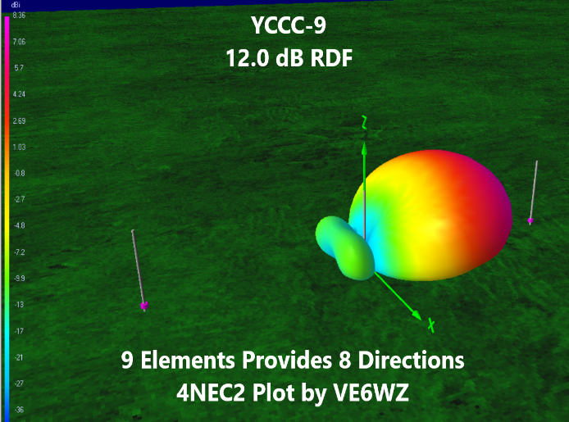
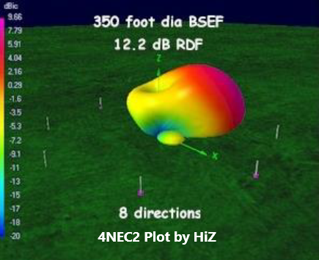
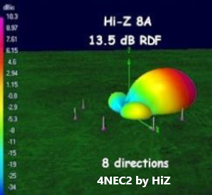
RDF was confirmed based on comparative signal analysis from eight azimuth directions for each array per station documented
F/B = 20 dB
RDF ~10 dB
3 dB BW = 75°
F/B = 20 dB
RDF ~12.1 dB
3 dB BW = 75°
F/B = 21 dB
RDF ~12.5 dB
3 dB BW = 50°
BSEF-8
Elevation Pattern
F/B = >30 dB
RDF ~13.45 dB
3 dB BW = 50°

Slide 35
DX Contest Performance
Detailed data was not collected during contest activity although the arrays have been evaluated in the major DX contests
Each array provided outstanding performance with a significant reduction in undesired signals and noise off the back and sides from areas other than the desired direction
This has been noted by W3LPL near the east coast using the BSEF-8 array
  Given the excellent pattern of these arrays, you will most likely not be able to hear Caribbean or South America stations calling you when focused on Europe during times when all of these areas are in darkness

Slide 36
Summary
Phased receiving arrays of short verticals provide superior performance over other low noise receiving antennas for 160 meters, including Beverages and loops
The low band receiving antenna appropriate for a specific location will depend on several factors, most importantly the available area for installation.

Slide 37
Summary
HiZ-8 160
The empirical results for the HiZ-8 160 array constructed in a 200 ft diameter circle confirms the modeling data and it has consistently been the top performing array at W5ZN. The design produces the best overall pattern that is sharp and clean
BSEF-8 160
The BSEF-8 160-meter array, configured in a 350 ft diameter circle, is a close second to the HiZ-8
The forward signal levels received were equivalent to the HiZ-8 however, the rear lobes do not provide an equivalent F/B or F/S as the HiZ-8 and as such does not produce the higher RDF seen with the HiZ-8. Regardless, this array is a top performer and ranked second in this evaluation

Slide 38
Summary
YCCC-9
The YCCC-9 in a 120 ft diameter circle provides amazing results in forward signal level and F/B
The deeper real null produced an improvement in F/B similar to the HiZ-8 and better than the BSEF-8 with several of the documented signals
It does not, however, provide improved results in forward signal and F/S data compared to the previous two arrays
For the amount of space required, though, this array cannot be summarily dismissed and is a top performer

Slide 39
Summary
YCCC-9
in this spacing configuration and with the correct delay lines described in the construction details this array can also be used on the 80- and 40-meter band with outstanding performance
You only need three of the elements for any one direction so if you have 120 ft available in a desired direction say, toward Europe, then installing three of these elements will give you the same or better performance as a 580 ft Beverage in 20% of the required space!
This array is very easy to construct

Slide 40
Final Thoughts
The array best suited for your location must be assessed and the criteria includes not only the area required but evaluation of the benefits and challenges that exist with each
On 160 meters, the HiZ-8 is the receive antenna used at W5ZN however, when conditions are marginal and extreme the HiZ-8 is used together with the BSEF-8 array in a diversity receive configuration with an Elecraft K4D (and previously with an Elecraft K3). This performance is nothing short of amazing and brings a signal just at the noise to a copyable level.

Slide 41
Future Evaluation Opportunities
The test described and performed for this work is simple, yet accurate
Technological advances in software and hardware components in recent years is currently being evaluated and used by industry professionals and radio amateurs who could build on the work conducted here
It is the authors desire that this can aid future confirmatory research efforts and possibly serve as a baseline for applying empirical data to modeled results

Slide 42
Complete Paper Available
www.w5zn.org

