Slide 1
Choking Without Suffocating
Greg Ordy, W8WWV
Chesterland, OH
w8wwv@arrl.net
ordy@seed-solutions.com
2025 Hamvention Antenna Forum

Slide 2
Contents
What is the choking problem? What problems do chokes solve?
How does resonance fit into the choke problem? (A lot!)
What is the impedance necessary in a common mode RF choke to drive current through it so low that the conductor being choked no longer causes a problem? (A successful choke)
How much choking is enough?
Are there other solutions/tools besides chokes? (Yes)
What won’t be explored is how to select materials (ferrite cores and cables) and build chokes – that’s well covered in many many many other places. Many commercial choke vendors too.
See References at the end.
Examples
Conclusion
References
Additional Material (previous note on the topic)

Slide 3
The Choking Problem
I hope we can all agree that an amateur radio station should have at least one antenna.
In addition to the antennas there could be:
Feed lines, control wires, towers, gutters, downspouts, flagpoles, metal guy lines, power lines, and lots of other metal.
Mother Nature is under no obligation to respect those different names and functions.
Any can act as an RF carrier (antenna), especially if a resonant size.
Flowing RF current will be radiated (even in a receive antenna).
When RF flows where it’s not wanted, the door opens to additional stations problems, including:
Antenna pattern distortion, reduced antenna performance, RFI, TVI, hot microphones, noise pickup, etc.
The solution is to block/reduce unwanted RF current flow, and that falls under the umbrella term of choking.

Slide 4
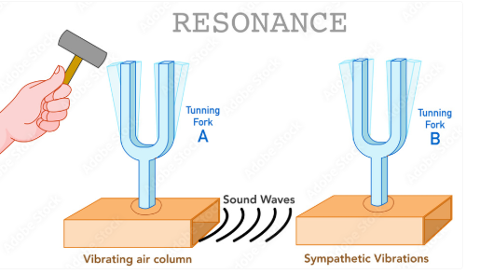
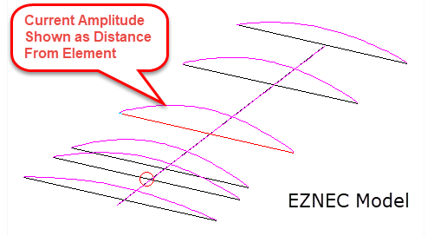
The Importance of Resonance
Remember this science demo from the school days?
Audio sympathetic vibrations.
You either excite a fork with a direct blow, or, from sound waves at the resonant frequency of the other fork (identical forks).
RF energy on conductors is similar. You can either directly drive it at a feed point, or, be a parasitic element picking up current through coupling to another excited conductor.
Resonance peaks the current.
Regardless of how the current gets there, it will be radiated, except for loss in the conductor.
How EZNEC indicates current.
This is how a Yagi works…
stock.adobe.com
Kopterinfo.ru

Slide 5
2024-2026 – The Centennial Years of the Yagi Antenna
It turns out the Yagi antenna was discovered/invented almost exactly 100 years ago!
Work began in 1924, paper in 12/1925, JA patent in 1926.
Should be called Yagi-Uda to properly credit both inventors.
RCA ended up with the USA patents in 1932.
Next year’s Antenna Forum? Centennial Celebration of the Yagi.
https://ethw.org/Milestones:Directive_Short_Wave_Antenna,_1924

Slide 6
Importance of Resonance (2)
What makes a conductor resonant?
Its length (size) allows it to carry peak available current at the resonant frequency.
If being excited, this usually implies zero Ohms of feed point reactance.
The two resonance rules (burned into my brain):
An electrical quarter wavelength element is resonant when there is a high impedance (e.g. open) on one end and a low impedance (e.g. ground) on the other. Current flows into the low impedance (e.g. 1/4 λ grounded vertical).
A half wavelength element is resonant when there is a high impedance on both ends. This implies a low impedance and high current in the middle. Consider a half wave dipole. Two quarter waves butted together. Maximum current in the middle. Highest voltage at the ends/opens.
Anti-resonance means reversing/breaking those rules. Float quarter wavelength to reduce current, ground ½ wavelength to reduce current.
The rules repeat with additional ½ wavelengths (1/4 ~ 3/4, etc).
A ¼ wavelength conductor open at one end is a low impedance (ground) at the opposite end. An artificial ground. (could radiate)

Slide 7
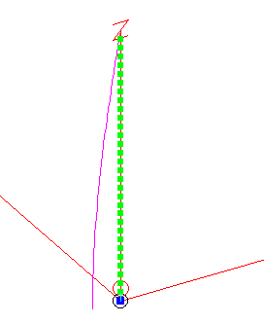
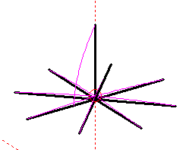
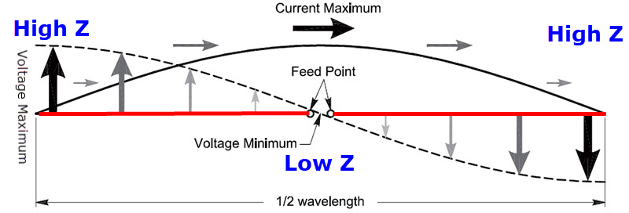
Importance of Resonance (3)
Ground/low impedance is not just earth!
Like a ground rod(s).
Some grounds are broadband, others are also resonant (frequency dependent).
¼ wavelength away from a high impedance is a low impedance.
180° on a Smith Chart.
A dipole is two back-to-back ¼ wavelength elements providing a low impedance to each other.
I’m going to make the claim that serious problems that require choking usually involve resonance since that peaks current flow which peaks reradiation.
These are standing waves.
Frequency Independent
Frequency Dependent
¼ WL Elevated Vertical with 8 radials
From the ARRL

Slide 8
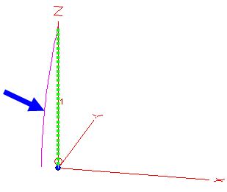
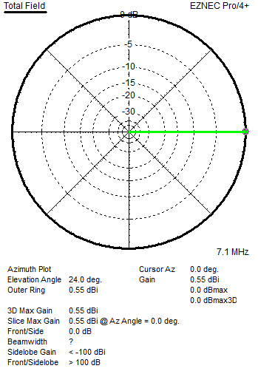
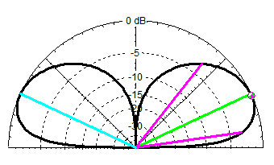
Importance of Resonance (4)
Let’s examine a 40m vertical example to get a better handle on resonance.
Single 40m vertical.
Characteristics:
#12 wire.
resonant at 7.1 MHz.
33.66’ tall.
36.76 – j 0.0008894 Ohms.
0.55 dBi gain.
No F/B, F/S (it’s omni!).
1500 watts in this note.
6.403 amps at feed point, which is at the base.
Max current at the base.
These characteristics define a single vertical antenna.

Slide 9
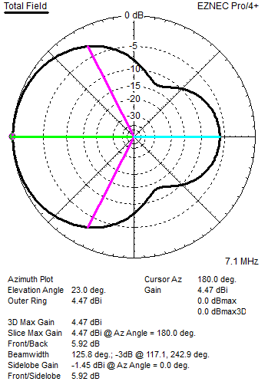
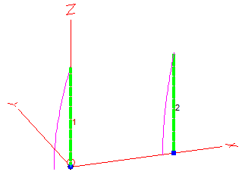
Importance of Resonance (5)
Let’s add a second identical grounded parasitic vertical ¼ wavelength away and see what happens.
Worst case – same polarization, broadside, close.
Parasitic must be grounded to be resonant (see the two rules).
Characteristic | Single | w/Parasitic
Impedance | 36.76 - j0.0 Ω | 30.87 + j 16.09 Ω
Maximum Gain | 0.55 dBi | 4.47 dBi
F/B | 0.0 dB | 5.92 dB
Current | 6.403 A | 6.990 A / 4.801 A
We have created a two-element parasitic array with decent gain and F/B (a reflector). Not a bad antenna, but not what we expect!
6.99 A in the driven, 4.801 A in the parasitic.
If you measure a single element and its impedance is way off target (model, theory), that might indicate coupling .

Slide 10
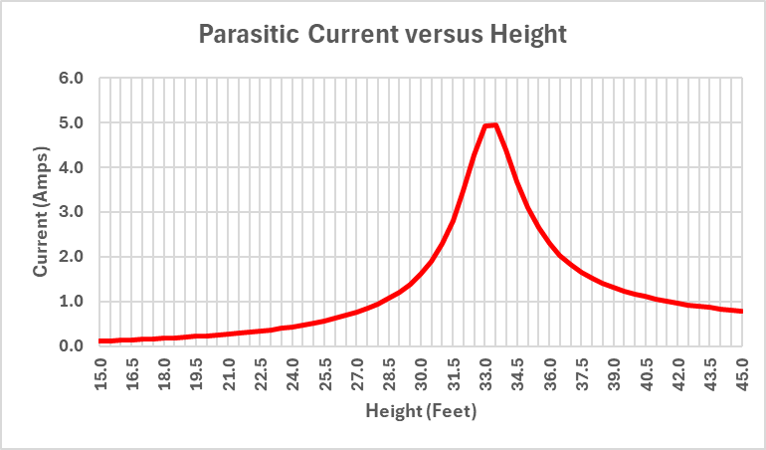
Importance of Resonance (6)
How important is the length of the parasitic?
Vary it from 15’ to 45’ in the model.
Beyond ±6’ of resonance the current drops by 80%. (±18% length)
40m: 6’, 10m: 1.5’.
A relatively small change in the length of the conductor can make a problem larger or smaller!

Slide 11
Importance of Resonance (7)
Can we choke the parasitic vertical so that it becomes invisible, and we restore the performance of the single omni vertical?
Let’s make it anti-resonant by floating the base, disconnecting it from ground.
This is the same as inserting an extremely high impedance choke since it’s an open circuit. Can’t get much better than that.
The test for being invisible is the return of the single vertical performance.

Slide 12
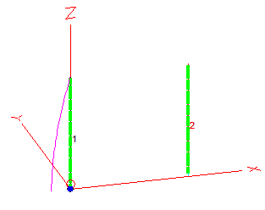
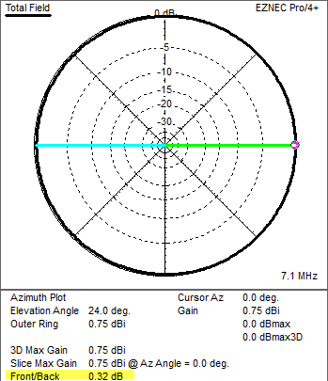
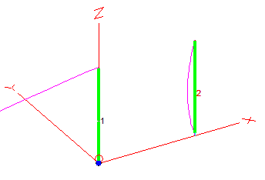
Importance of Resonance (8)
Lift Wire #2 0.1’ off the ground.
Some current still flows in Wire #2. It will never be zero.
Characteristic | Single | w/Parasitic
Impedance | 36.76 - j0.0 Ω | 36.26 – j 0.21 Ω
Maximum Gain | 0.55 dBi | 0.75 dBi
F/B | 0.0 dB | 0.32 dB
Current | 6.403 A | 6.447 A / 0.140 A
I would claim it would be very hard to detect the presence of the parasitic.
To make the parasitic even more invisible it would be necessary to break up the element into smaller pieces with additional opens or chokes.
Every conductor picks up current, it’s just a question of how much
Current zoom maximized

Slide 13
Importance of Resonance (9)
Floating the parasitic is the same as putting a high impedance at the base, so high impedances on both ends of a ¼ λ element.
NOTE: floating is no different than a very high impedance choke!
Very high resistance and high capacitive reactance (the “gap”).
This is an anti-resonant configuration.
Common technique for measuring self impedance of a vertical when other verticals present and can’t be easily removed.
Array design is built upon self and mutual impedance values, and self really means self (not influenced by the other elements).
We can see that this is close to removing the other verticals, but not precisely identical. It’s usually good enough.
One of the reasons why arrays of shunt fed verticals are challenging, because you can’t float them easily (always grounded).
Whatever current profile exists will have the maximum in the middle and the minimum at the high impedance ends. It’s just a short nonresonant dipole.

Slide 14
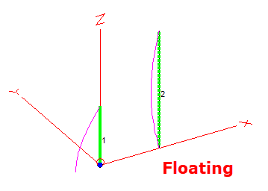
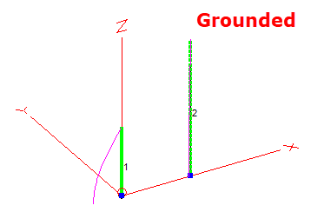
What About ½ λ Conductors?
Do you really ground (low impedance) a ½ λ element to make it anti-resonant?
Current is greatly reduced by grounding at the bottom.
Is it perfect, no, but if you wanted it better add some more chokes.
After all, it is a full size ½ λ vertical dipole stuck right next to a resonant vertical.
This also shows why both grounds and chokes (low and high impedances) are both tools in the fight against unwanted antenna currents.
They can both help and hurt!
In an attempt to choke the heck out of it, don’t add a choke ½ way up the parasitic since you will create a grounded ¼ λ vertical below it!
Also called voltage feeding at high impedance point.

Slide 15
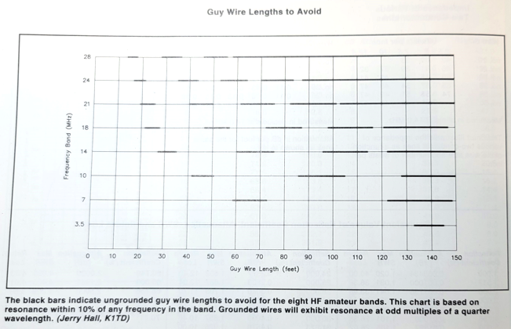
Importance of Resonance (10)
Before Phillystran and fiberglass guy lines adding insulators to metal guy lines was common to avoid resonant lengths.
An insulator is a high impedance choke.
ARRL Handbook, 2000.

Slide 16
Instead of Opens What About R & X?
Let’s examine a range of R and X values placed in the middle of the parasitic vertical (like a real RF choke).
How effective are they in cutting off current flow?
Start with pure resistance then reactance.
Judge choking efficacy by checking for influence on the driven vertical and currents in the parasitic.
Also keep an eye on loss in the choke and the power it dissipates.
There are two ways that I know of to keep RF current from flowing past some point:
Absorb it or reflect it. Absorption leads to heat.

Slide 17
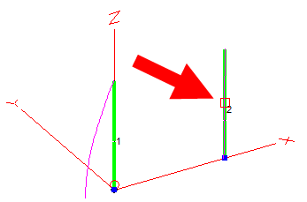
Resistive Choke
Chokes will be placed at the 50% point of the parasitic vertical (still grounded).
Another interesting place to locate a choke would be at the base.
We already did that with the open.
Vary resistance through 4 ranges recording the F/B dB (0 dB is the ideal) and the power dissipated in the resistor. 0 to 15K Ohms.
F/B is just one of several characteristics we can track to see how invisible the parasitic becomes.
Details in the slides at the end.

Slide 18
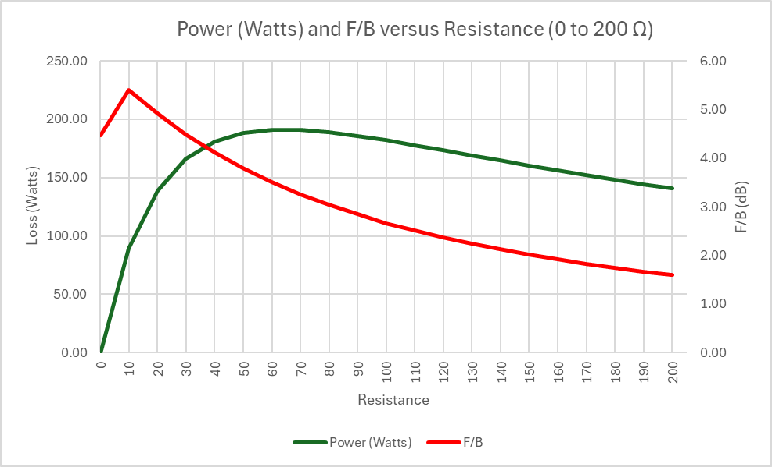
Resistive Choke (2)
0 to 200 Ohms.
Maximum of almost 200 watts (out of 1500).
This is an absolute worst-case since the transmitter is 33’ away!
View these results as relative.
F/B peaks due to better array current ratio due to loss.

Slide 19
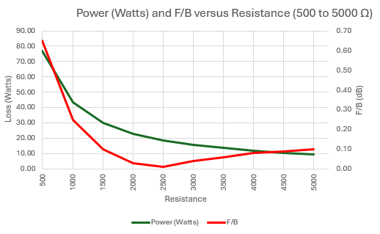
Resistive Choke (3)
Loss continues to drop.
F/B bottoms out and drifts at a low value.
There are other reasons for chokes to heat up. This is just common mode resistance.
Continued to 15K Ohms.
Point of diminishing returns around 3,000 Ohms.

Slide 20
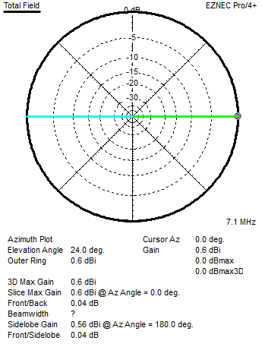
Resistive Choke (4)
What is the 3000 + j 0 Ohm choke performance?
Characteristic | Single | w/3000 Ω Choke
Impedance | 36.76 - j0.0 Ω | 36.3 + j 0.25 Ω
Maximum Gain | 0.55 dBi | 0.6 dBi
F/B | 0.0 dB | 0.04 dB
Current | 6.403 A | 6.444 A (driven) 0.177 A (base parasitic)
With a 3000 Ohm Resistance Choke:
Current drops from 4.801 A to 0.177 A (-28.7 dB)
Performance is better than floating the base.
15.66 watts in the resistor (1% of total power).

Slide 21
Resistance Summary
With 3000 Ohms of pure resistance, we have made the parasitic quite invisible.
This is 3000 Ohms at the frequency of interest.
Better than floating the base.
Resistance makes an effective choke.
Low resistance values suffer from too much loss (power in the resistor).
Don’t forget, this is a worst case with 1500 watts ¼ λ away!
A good choke is like an open circuit which means new resonances could be created at higher frequencies.

Slide 22
Power Formula
We are all familiar with the formula:
$P=I^{2}R$
More resistance is more power.
While this is true for a constant I (current), we don’t have constant current since increasing R reduces current and current is squared, overall effect is a reduction in choke power as R rises.

Slide 23
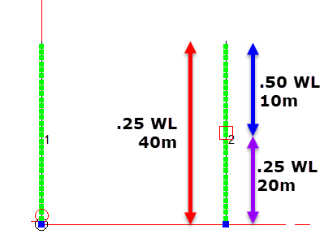
No Good Deed Goes Unpunished
One man’s ¼ λ is ½ λ at twice the frequency.
When adding a choke or grounds, consider if you are creating a problem at a different important frequency.
Perhaps we should have picked a different location to not create new resonances on amateur bands?
Location, location, location.

Slide 24
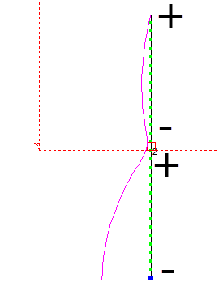
It’s Hard to Reduce Current to Zero Through the Choke
It’s hard to reduce the current flow to zero because the choke creates, in effect, two colinear elements with opposite polarity voltages.
This is with a 20,000 Ohm resistor.
Note that minus and plus straddle the gap meaning that there is a voltage drop across the choke that will cause current to flow.
This does assume physical alignment so that the induced current flow has the shown polarity.
Perhaps several average chokes are more effective than one very high impedance choke?
If you never let a large current build up, you have less to knock down.
A true open line does not have a second part.
This is 40m
(zoomed in)

Slide 25
Reactance Choke
Follow the lead of the resistance measurements with inductance (L) and capacitance (C). 0 to 15,000 Ohms.
Assume infinite Q, no resistance.
Positive reactance is inductive.
Negative reactance is capacitive.
Will plot capacitive as positive just to make comparisons easier on the graph. Use the graph legend to sort out inductive and capacitive.
Let’s not forget that a small amount of inductive reactance makes an element electrically longer (loading).
A small amount of capacitive reactance makes an element electrically shorter.

Slide 26
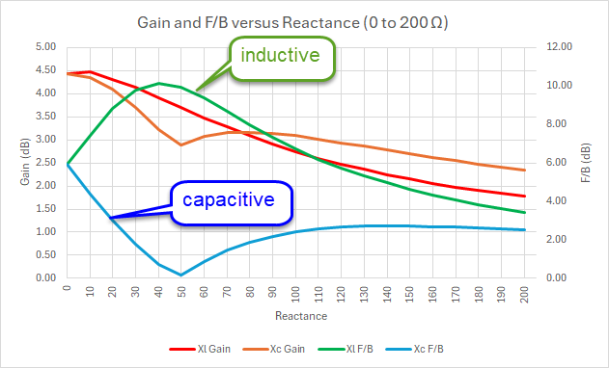
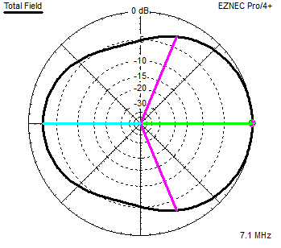
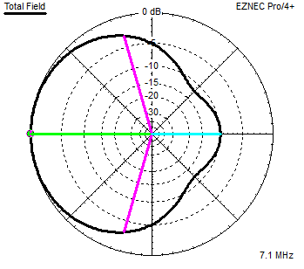
Reactance Choke (2)
Parasitic is either a reflector or director based upon inductive or capacitive reactance.
Gain drops when switching directions.
These reactance values are clearly too close to zero to be any sort of choke.
They just nudge the element length.
That might be good enough.
Since lossless L and C no power is dissipated.

Slide 27
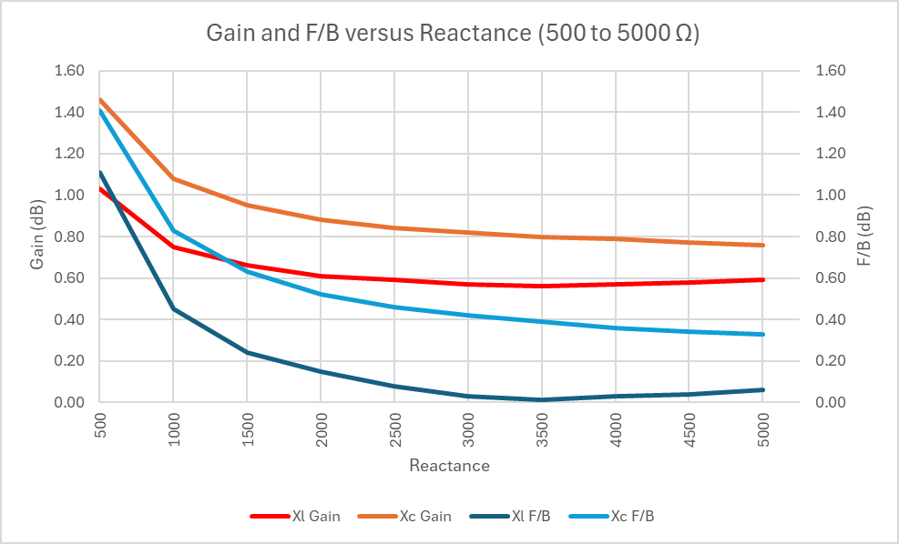
Reactance Choke (3)
Around 3,000 Ohms performance flattens out, which was similar to the pure resistance choke.
This appears to be a coincidence.

Slide 28
Reactance Summary
With 3000 Ohms of pure reactance, we have made the parasitic quite invisible.
That’s 3000 Ohms at the frequency of interest.
Inductive or capacitive.
Better than floating the base.
Reactance makes an effective choke.
It creates an impedance mismatch and then reflection.
Low reactance values simply nudge the resonant frequency as opposed to creating a large mismatch that current finds hard to cross.
Practical chokes will be a combination of resistance and reactance.

Slide 29
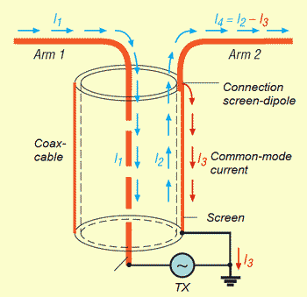
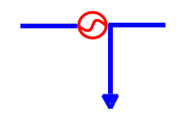
Chokes at Feed Points
Palomar Engineers graphic
Let’s look at the often-cited example of a dipole/Yagi feed point (they are balanced).
A coaxial cable is actually three wires, not two (with respect to RF).
Outside of the inner conductor.
Inside of the outer conductor (shield, braid).
Outside of the outer conductor (skin effect separates inside from outside).
1 and 2 are equal magnitude and opposite direction (transmission line differential currents – they cancel and don’t radiate).
3 is the common mode current and is what we are trying to choke (antenna currents – radiate).
Unbalanced means an explicit ground reference. Balanced means no ground reference.
How it’s
modeled

Slide 30
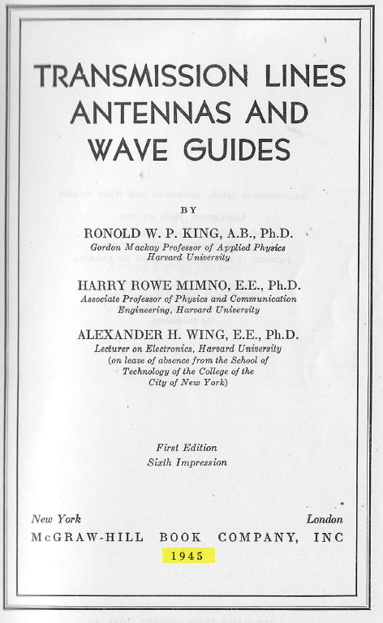
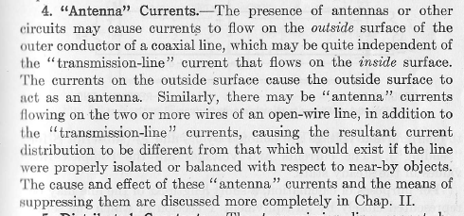
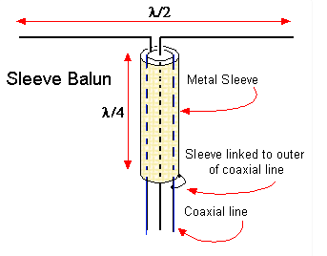
Chokes at Feed Points (2)
This third wire stuff is not new.
Until ferrite and similar materials came along about all you could do is create monoband chokes that exploited anti-resonance.
A challenge at HF due to length of the sleeve.
This is a ¼ λ shorted stub.

Slide 31
Chokes at Feed Points (3)
Installing a common mode current choke at an unbalanced/balanced feed point junction has become standard practice in recent decades.
It is performing the balun function.
It’s a very good idea!
The idea is to discourage current from flowing back down the outside of the transmission line as if it were part of the antenna.
Can block current from coming back into the transmission line too.
All the rules of resonance apply to that current.
The choke creates a high impedance point similar to an open.
Common mode current does radiate.
If there is going to be a heat problem with a choke, it is probably a feed point choke, with QRO power levels and substantial antenna/transmission line imbalance.
The transmission line is the preferred antenna!

Slide 32
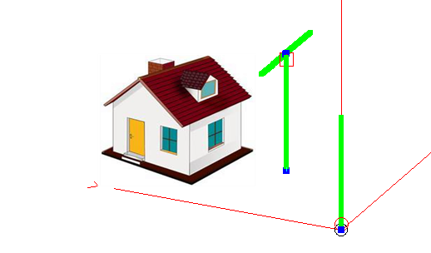
Example 1
Let’s consider a station with a 20m dipole up at 33.5’ and a multiband vertical a short distance away (about 45 feet).
The dipole has a feed point choke, Z = 3000 + j 3000 Ohms.
As is also good practice, the dipole coax is grounded through a surge/lightning protector down at the ground.
See: Grounding and Bonding for the Radio Amateur, Ward Silver, N0AX.
If the feedline to the dipole radiates then being close to the house can lead to RFI and TVI even if the “antennas” are further away.
Common mode current can drag the antenna into the shack.

Slide 33
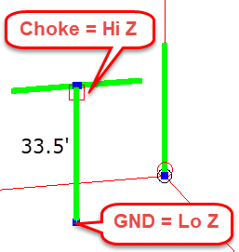
Example 1 (2)
What, if anything, is resonant?
Congratulations! It’s a 40m open/grounded ¼ λ vertical.
Can we add a choke at the ground? Yes, but in what order with respect to the surge protector?
Choke first, then surge protector to create two adjacent opens.
Choke is more exposed to surges, but necessary in that order.
What about 20m? With choke first it’s now a floating 1/2 λ.
Now you want the ground first then the choke!
Chokes near the station are sometimes called line isolators.
Different name, same purpose (insert a high impedance).
What about the 20m dipole??? What’s going on there?

Slide 34
Example 1 (3)
Maximum current in the coaxial vertical depending upon termination and length.
Actual driven vertical current: 6.5 A
Coax: Terminated with ground (low/high): 1.15 A
Terminated with two chokes (high high): 0.069 A (17X lower than 1.15)
Highest current point in the middle of the span, with chokes on the ends.
Make transmission line 24’ long with ground (low/high): 0.24 A
Ok, not desirable, but shows that length matters.
Note difference between physical length of coax versus electrical.
Perhaps 0.95 VF on outside and 0.66 to 0.84 VF as a transmission line.
Some chokes come with a grounding lug connected to one side of the choke. We can now see how that can be useful but get the direction right!
The resonance of the 20m dipole depends upon the impedance at the feed point.
The feed point is connected to some length of transmission line that is then terminated near the station with some impedance.
What is that? Short, open? Something else?

Slide 35
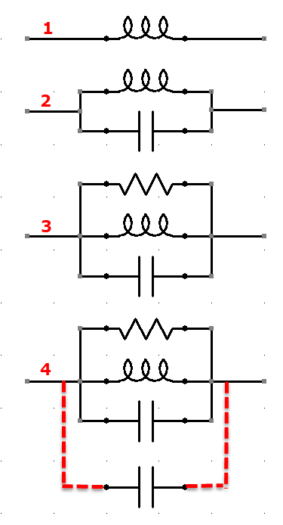
Choke Anatomy and Reality
What we build. Conductor wrapped around ferrite. An inductor!
What we get (usually within HF).
Parallel resonance adds resistance as does the ferrite (like an antenna trap). That’s why we use ferrite.
Stray capacitance around the choke can shift down the impedance curve in frequency. Not necessarily bad, but different – it’s unexpected. The higher the choke impedance the greater the effect of stray C.
E.g. 5 pf at 8 MHz is 4,000 Ohm of Xc.

Slide 36
Stray Capacitance is Sneaky
Metal enclosures short circuit the choke!
Chokes are enclosed in plastic/insulating boxes/tubes.
Having a metal box with an insulated coax connector works, but there will be capacitance due to the metal box. (just make sure you measure it in the box)
Bead baluns/chokes can be taped to Yagi booms, but the boom provides shunt capacitance while near the choke. The choke can be held away from the boom to reduce stray capacitance. A commercial solution is:

Slide 37
Can the Choke |Z| Be Too High?
Not really but holding onto very high impedances in practice can be a challenge.
The highest impedance chokes I’ve seen are around 20K Ohms (|Z|).
The higher the choke impedance the more influence stray shunt capacitance has since it is in parallel with the choke.
If you have made high impedance chokes a goal, give some consideration to how they are mounted and if excessive stray capacitance can sneak in.
This does not wreck the choke but does shift the performance compared to what’s measured on the bench. You have something different that you think.

Slide 38
Is it Impedance or Attenuation?
Historically, chokes were measured like any other two terminal device (R, L, C) with the results being impedance magnitude, resistance and reactance plots versus frequency in Ohms.
In recent times, some chokes have been characterized in terms of common mode signal attenuation measured in dB.
Although this sounds like apples and oranges the two approaches produce the same results and can be converted from one to the other.
Stray capacitance can also be part of the test jig, so the measurement approach is another source of stray C.

Slide 39
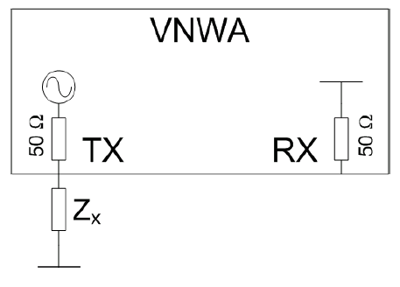
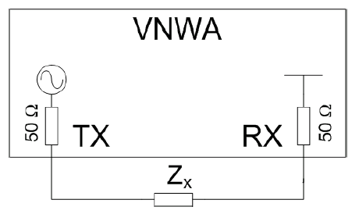
Ohms vs dB
Figures taken from the VNWA user manual.
Inexpensive and high quality two port VNAs, like the NanoVNA, are now available. This is no longer exotic stuff!
Results are insertion loss and phase shift measured in dB and degrees.
S21 or transmission measurement.
Like an Antenna analyzer.
Results are R, X, Z Ohms.
S11 or reflection measurement.
For the special case of two terminal (one port) passive devices, the results of one measurement can be converted into the other with a bit of complex math.

Slide 40
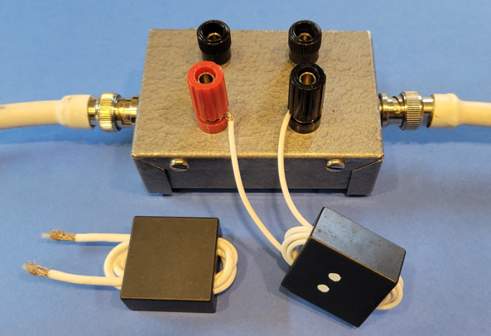
Ohms vs dB (2)
Transmission (S21) measurements made through the choke will be more accurate at high impedance levels due to limitations in reflection bridges. (when converted to a reflection measurement (S11))
Using transmission to reflection measurements is inaccurate at low impedance values.
Making highly accurate impedance measurements from around zero Ohms to over 10,000 Ohms turns out to be a challenge due to inherent limitations in the measurement approaches.
3 different approaches are needed (RF-IV) based upon the target range.
Example choke for next slide. A few turns of thin coax on a binocular core.
This is a transmission setup.
Is that some shunt C I’m letting in with the metal box?

Slide 41
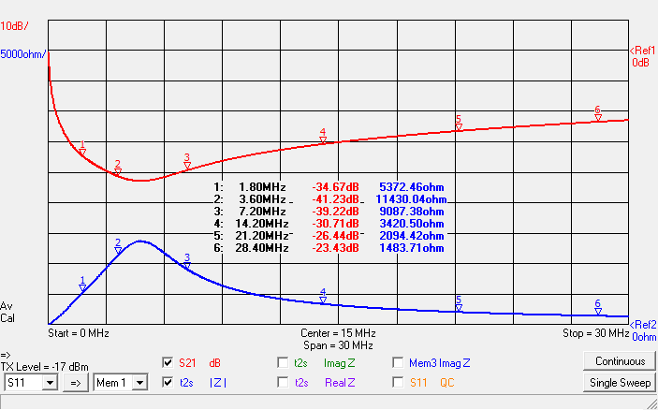
Ohms vs dB (3)
Great for up to 10 MHz. Not so good above 10 MHz.
What would more turns do?

Slide 42
Ohms vs dB (4)
Real HF chokes will have a peak impedance at some frequency in the range.
Parallel resonance with maximum R and X = 0.
As you might guess, this is often the impedance advertised with the choke.
I’ve never seen a flat and high impedance response. I don’t think it’s possible.
I tend to think of chokes as peaking under 15 MHz or above 15 MHz. How does that correspond to my needs?
The example choke is good under 15 MHz, not above, given my 3000 Ohm minimum. A lower band choke.

Slide 43
Difficult Situations
Some chokes do fail due to heating of the ferrite.
This is most always on a transmission line with QRO power and severe imbalance on the antenna so that the preferred current path is down the feedline.
This could be an off center fed dipole or a transmission line far from perpendicular to the antenna.
Here is where a higher impedance choke can be helpful. (or, more than one choke in series)

Slide 44
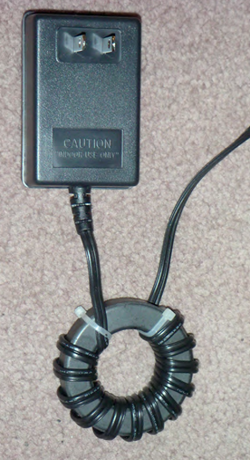
Choking Switching Supplies
The 2006 W1HIS (Chuck Counselman) note covers this topic in detail (SMPS).
Wall-warts and similar switching supplies (chargers) are now everywhere and cheap!
We are now keeping their noise from us.
Noise is usually worse in the first few MHz.
Choke near the supply to reduce the ampere-feet.
To be effective, at least 6 turns are usually needed (note 13 in picture).
Simply clamping on does very little (unless VHF/UHF is involved).
Some noise problems can be differential mode, not just common mode. (Line filter)
W1HIS, 2006

Slide 45
Can You Choke a Gutter?
Let’s say you discover that when you point your Yagi at the garage the rear gutter clearly picks up lots of power from the antenna and RFI in the house goes up and the Yagi SWR rises too.
Can you choke a gutter?
You probably can’t wrap the gutter around ferrite.
You probably can’t wrap ferrite around the gutter.
But you can ground it in different places and even hang wires off of it that aren’t grounded to change the length, perhaps avoiding resonance (multiple bands?).
The current doesn’t have to go to zero to knock down a problem to an acceptable level.
Length matters!

Slide 46
Conclusion
The tools for reducing unwanted RF current flow are:
Chokes (high Z), Ground (low Z), Length changes.
Choke impedance magnitude of at least 3000 Ohms should be enough for most situations.
Some early sources suggest ~1000 Ohms. Not enough.
This means 3000 Ohms at a target frequency.
Resonance can exacerbate a problem.
Feed point chokes that provide the balun function are a good idea.
Grounding near the station is a good idea.
Chokes (line isolators) are often a good idea at the station, especially if ground there is of poor quality.
The ordering of chokes and grounds can matter.

Slide 47
Conclusion (2)
A solution for one band can create problems on another.
Shift resonances in between bands.
Choking a high common mode current point is most effective.
Additional chokes/grounds might be needed.
Measuring chokes accurately is not easy.
The most bulletproof choked line would have a high impedance choke located every ¼ wavelength down the line at the highest frequency of operation.
If that’s 10 meters, then that’s every ~8 feet!
Nobody is going to do that!

Slide 48
References
https://yccc.org/common-mode-chokes-by-w1his (Dr. Chuck Counselman, W1HIS)
http://k9yc.com/RFI-Ham.pdf (Jim Brown, K9YC)
http://k9yc.com/2018Cookbook.pdf (Jim Brown, K9YC)
http://k9yc.com/2018Cookbook-Pacificon2021.pdf (Jim Brown, K9YC)
https://hamwaves.com/chokes/doc/k9yc.chokes.pdf (Jim Brown, K9YC)
http://karinya.net/g3txq/chokes (Steve Hunt, G3TXQ, (SK))
http://karinya.net/g3txq/baluns (Steve Hunt, G3TXQ, (SK))
https://www.qsl.net/g1cqp/ref/chokeimped.html (Steve Hunt, G3TXQ. (SK))
https://www.w8ji.com/common_mode_current.htm#What_Does_a_Common_Mode_Choke_Do (Tom Rauch, W8JI)
https://www.w8ji.com/core_selection.htm (Tom Rauch, W8JI)

Slide 49
References (2)
https://w5sc.org/wp-content/uploads/2020/01/Yagi-Antenna-Talk-for-Fiesta-2019.pdf (Tom O’Brien, AB5XZ)
https://palomar-engineers.com/wp-content/uploads/Choosing-a-Feedline-Choke-Palomar-Engineers-2022-Update-by-AK6R.pdf (Bob Brehm, AK6R)
https://palomar-engineers.com/wp-content/uploads/Choosing-a-Feedline-Choke-RFI-Tip-Sheet-RC-1-by-AK6R.pdf (Bob Brehm, AK6R)
https://www.na0tc.org/lib/exe/fetch.php?media=technical:balun_p1_final.pdf (Bill Leonard, N0CU)
http://karinya.net/g3txq/chokes/ (Steve Hunt, G3TXQ (SK))
http://karinya.net/g3txq/baluns/baluns.pdf (Steve Hunt, G3TXQ (SK))
https://www.eznec.com/Amateur/Articles/Baluns.pdf (Roy Lewallen, W7EL)
Grounding and Bonding for the Radio Amateur (Ward Silver, N0AX).

Slide 50
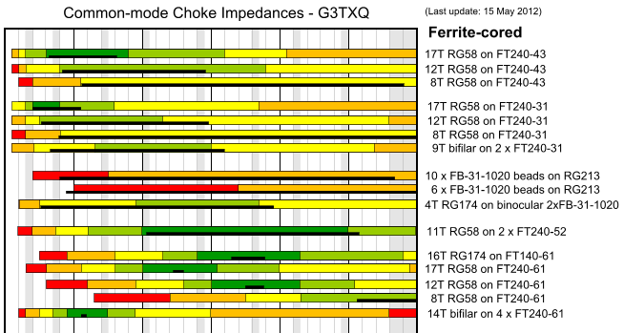
Additional Material
From Steve Hunt, G3TXQ (SK):
The following slides were prepared last November on the same topic.

Slide 51
Resistance and Reactance in Chokes
Greg Ordy, W8WWV
October, November 2024
Version 1.02

Slide 52
Motivation
I struggle with several questions surrounding RF chokes.
How do resistance and reactance impact choking performance?
How much choking resistance/reactance/impedance is enough?
Choking is really about reducing current flow where antenna current should not flow.
Antenna current should only flow on antenna elements (not coax, gutters, power lines, etc).
The tools are both chokes (high impedance) and ground (low impedance (infinite sink of current)).
Chokes and grounds in the wrong places can make a problem worse.
An improvement at one frequency usually implies a potential problem at another higher frequency.
Current flow reradiates and/or flows into conductors, both can cause problems.
One thought I have is that in situations where the lack of choking is a significant problem some conductor is near resonance. Resonance peaks current or voltage, not power.
The two resonance rules:
A quarter wavelength element is resonant when there is a high impedance on one end and a low impedance (ground) on the other. Current flows into the low impedance (1/4 λ grounded vertical).
A half wavelength element is resonant when there is a high impedance on both ends. This implies a low impedance and high current in the middle. Consider a half wave dipole. Two quarter waves butted together. Maximum current in the middle.
Anti-resonance means reversing/breaking those rules. Float quarter wavelength to reduce current, ground ½ wavelength to reduce current.

Slide 53
Use EZNEC Modeling
Use EZNEC models to investigate choking behavior.
40m verticals over ground.
One driven, one parasitic.
Spacing is ¼ λ.
The idea is to force as much current as possible into the parasitic.
Make it as resonant as possible to create a worst-case problem to solve.
Use choking to try to eliminate current on the parasitic vertical.
In other words, make it electrically invisible to the driven one.
Is this approach any good? Highlights concepts.

Slide 54
Single Vertical Performance
Characteristics:
#12 wire.
resonant at 7.1 MHz.
33.66’ tall.
36.76 – j 0.0008894 Ohms.
0.55 dBi gain.
No F/B, F/S (it’s omni!).
1500 watts in this note.
6.403 amps at feed point.
Deviation from these shows influence of parasitic- i.e. ineffective choking.
Current
profile

Slide 55
Add in the Parasitic Vertical
Parasitic must be grounded to be resonant (see the two rules).
Characteristic | Single | w/Parasitic
Impedance | 36.76 - j0.0 Ω | 30.87 + j 16.09 Ω
Maximum Gain | 0.55 dBi | 4.47 dBi
F/B | 0.0 dB | 5.92 dB
Current | 6.403 A | 6.990 A / 4.801 A
We have created a two element parasitic array with decent gain and F/B (a reflector).
6.99 A in the driven, 4.801 in the parasitic.

Slide 56
Floating the Parasitic
Floating the parasitic is the same as putting a high impedance at the base, so high impedances on both ends of a ¼ λ element.
NOTE: floating is no different than a very high impedance choke!
Very high resistance and high capacitive reactance (the “gap”).
This is a nonresonant configuration.
Common technique for measuring self impedance of a vertical when other verticals present and can’t be easily removed.
Array design is built upon self and mutual impedance values, and self really means self (not influenced by the other elements).
One of the reasons why arrays of shunt fed verticals are challenging, because you can’t float them easily.
Whatever current profile exists will have the maximum in the middle and the minimum at the ends. It’s just a short nonresonant dipole.

Slide 57
What’s the Floating Performance?
Lift Wire #2 0.1’ off the ground.
Some current still flows in Wire #2.
Characteristic | Single | w/Parasitic
Impedance | 36.76 - j0.0 Ω | 36.26 – j 0.21 Ω
Maximum Gain | 0.55 dBi | 0.75 dBi
F/B | 0.0 dB | 0.32 dB
Current | 6.403 A | 6.447 A / 0.140 A
To make the parasitic even more invisible it would be necessary to break up the element into smaller pieces with additional opens or chokes.
Current Magnified

Slide 58
What about ½ λ Verticals?
Also called voltage feeding at high impedance point.
Do you really ground (low impedance) a ½ λ element to make it nonresonant?
Current is greatly reduced by grounding at the bottom.
Is it perfect, no, but if you wanted it better add some more chokes.
After all, it is a full size ½ λ vertical dipole stuck right next to a resonant vertical.
This also shows why both grounds and chokes (low and high impedances) are both tools in the fight against unwanted antenna currents.
In an attempt to choke the heck out of it, don’t add a choke ½ way up the parasitic since you will create a grounded ¼ λ vertical!

Slide 59
Instead of Opens/Grounds, how about R & X?
Let’s examine a range of R and X values placed in the middle of the parasitic vertical (like an RF choke).
How effective are they in cutting off current flow?
Start with pure resistance.
Judge choking efficacy by checking for influence on the driven vertical and currents in the parasitic.
Also keep an eye on loss in the choke and the power it dissipates.
There are two ways that I know of to keep RF current from flowing past some point:
Absorb it or reflect it.
To absorb it you must direct it into a matched resistive load.
To reflect it you must direct it into an impedance mismatch.
Does a mismatched resistance absorb, reflect, or some of both?
All a reactance can do is reflect, with some loss related to the Q.

Slide 60
Resistance Chokes
Chokes will be placed at the 50% point of the parasitic vertical (still grounded).
Another interesting place to locate a choke would be at the base.
Vary resistance through 4 ranges recording the F/B dB (0 dB is the ideal) and the power dissipated in the resistor.
F/B is just one of several characteristics we can track to see how invisible the parasitic becomes.

Slide 61
Resistance of 0 to 200 Ohms
Maximum of almost 200 watts (out of 1500).
This is the absolute worst-case since the transmitter is 33’ away!
View these results as relative.
F/B peaks due to better array current ratio due to loss.

Slide 62
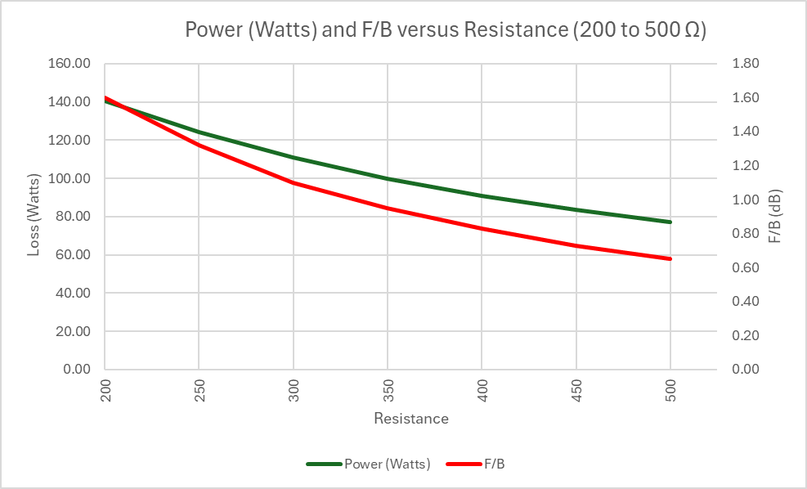
Resistance of 200 to 500 Ohms
Loss and F/B both continue to drop.

Slide 63
Resistance of 500 to 5000 Ohms
Loss continues to drop.
F/B bottoms out and drifts at a low value.

Slide 64
Resistance of 5000 to 15000 Ohms
Loss continues to drop.
F/B continues to drift at a low value.

Slide 65
Around 3000 Ohms Loss is ~Flat
What is the 3000 + j 0 Ohm choke performance?
Characteristic | Single | w/3000 Ω Choke
Impedance | 36.76 - j0.0 Ω | 36.3 + j 0.25 Ω
Maximum Gain | 0.55 dBi | 0.6 dBi
F/B | 0.0 dB | 0.04 dB
Current | 6.403 A | 6.444 A (driven) 0.177 A (base parasitic)
With 3000 Ohm Resistance Choke:
Current drops from 4.801 A to 0.177 A (-28.7 dB)
Performance is better than floating the base.
15.66 watts in the resistor.

Slide 66
Resistance Summary
With 3000 Ohms we have made the parasitic quite invisible.
Better than floating the base.
Resistance makes an effective choke.
Low resistance values suffer from too much loss (power in the resistor).
Don’t forget, this is a worst case with 1500 watts ¼ λ away!
A good choke is like an open circuit which means new resonances could be created at higher frequencies.
Below the choke is a resonant ¼ λ 14.2 MHz grounded vertical.
Above the choke is a resonant ½ λ 28.4 MHz dipole.
Will these cause problems? Who knows. But they exist as a side effect of addressing 40m.

Slide 67
It’s hard to Reduce Current to Zero
It’s hard to reduce the current flow to zero because the choke creates, in effect, two colinear verticals with opposite polarity voltages.
This is with a 20,000 Ohm resistor.
Note that minus and plus straddle the gap meaning that there is a voltage drop across the choke that will cause current to flow.
This does assume physical alignment so that the induced current flow has the shown polarity.
Perhaps several average chokes are more effective than one very high impedance choke?
If you never let a large current build up, you have less to knock down.
GND

Slide 68
Reactance Chokes
Follow the lead of the resistance measurements with inductance and capacitance.
Assume infinite Q, no resistance.
Positive reactance is inductive.
Negative reactance is capacitive.
Will plot capacitive as positive just to make comparisons easier on the graph. Use the graph legend to sort out inductive and capacitive.
Let’s not forget that a small amount of inductive reactance makes an element electrically longer (loading).
A small amount of capacitive reactance makes an element electrically shorter.

Slide 69
Reactance of 0 to 200 Ohms
Parasitic is either a reflector or director based upon inductive or capacitive reactance.
Gain drops when switching directions.
These reactance values are clearly too close to zero to be any sort of choke.
They just nudge the element length.
Since lossless L and C no power dissipated.
+30
-100

Slide 70
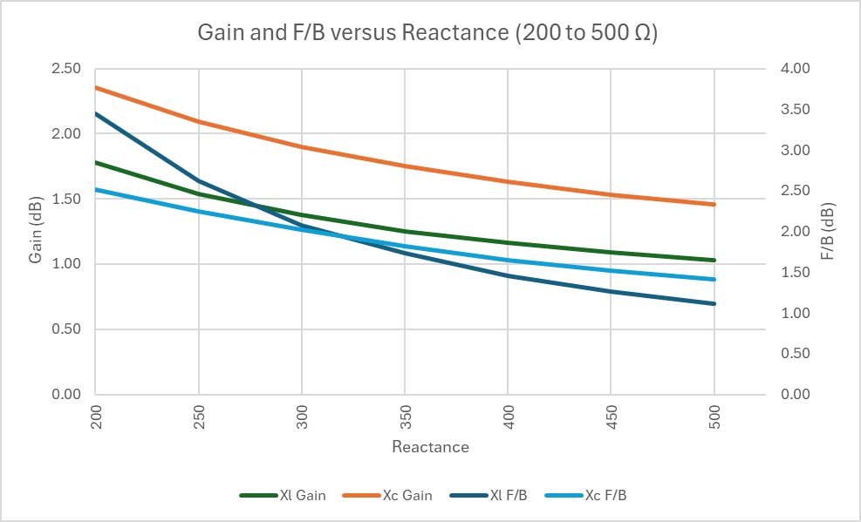
Reactance of 200 to 500 Ohms
Both gain and F/B are settling down to the expected values for no parasitic vertical.

Slide 71
Reactance of 500 to 5000 Ohms
Around 3000 Ohms things flatten out, which was like the pure resistance choke.

Slide 72
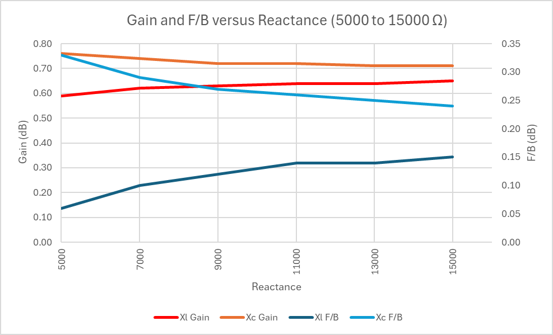
Reactance of 5000 to 15000 Ohms
0.55 dB gain is neutral (gain without a second vertical).
NOTE: dB should be dBi.

Slide 73
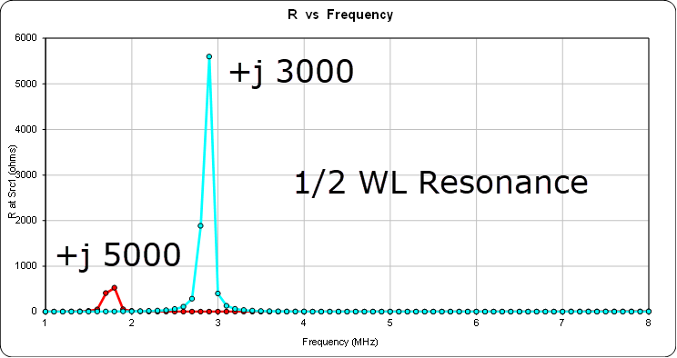
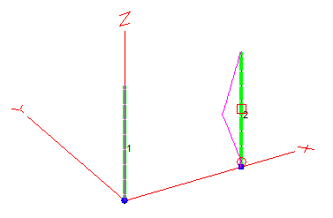
Is it that Simple?
Low values of reactance are going to be electrical loading, moving the resonance higher or lower in frequency.
Low value reactances act to electrically lengthen or shorten vertical, like normal loading.
Danger of low resistance is heating; danger of low reactance is small change in length.
When you insert a choke, the interesting question may be what is left behind and does that create a new problem on other frequencies.

Slide 74
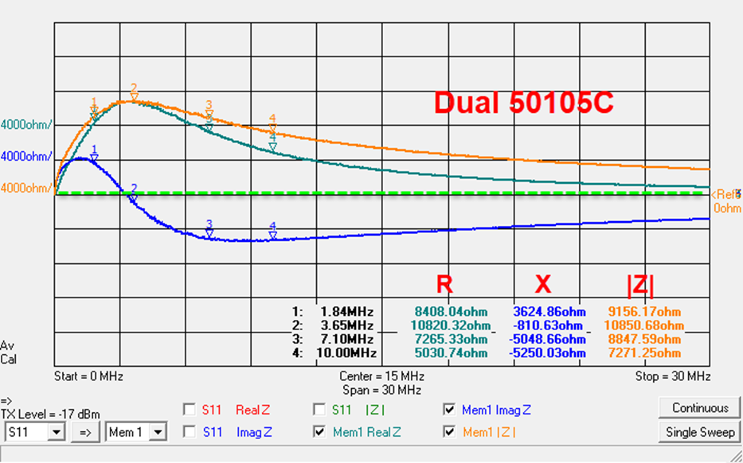
Resistance and Reactance
Resonance matters.
Like the old days of breaking up resonances on metal tower guys with insulators.

Slide 75
Chokes at Feed Points
Let’s look at the often-cited example of a dipole/Yagi feed point.
A coaxial cable is actually three wires, not two (with respect to RF).
Outside of the inner conductor.
Inside of the outer conductor.
Outside of the outer conductor (skin effect separates inside from outside).
1 and 2 are equal magnitude and opposite direction (transmission line currents – cancel).
3 is the common mode current and is what we are trying to choke (antenna currents – radiate).

Slide 76
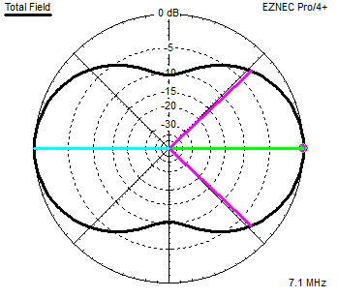
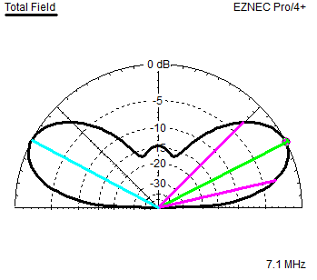
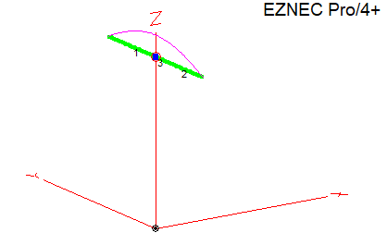
40 Meter ½ λ Dipole at 70’
67.8’ long, 70’ high.
Z = 58.12 –j 0.1 Ohms.
8.51 dBi max gain.

Slide 77
This 3rd Wire Stuff is Not New
Until ferrite and similar materials came along about all you could do is create monoband chokes that exploited resonance.
A challenge at HF due to length of the sleeve.

Slide 78
Add in the Common Mode 3rd Wire
Let’s assume that a very high-quality choke was placed about ¼ λ from the feed point.
That high impedance will be transformed into a low impedance right at the dipole feed point on the ground side.
This encourages current to flow down the coax since the low impedance is in competition with the dipole arm.
This would be the worst possible place to locate a choke.
It’s the opposite of the sleeve balun.
Let’s use this example to investigate the effect of the choke placement (i.e. length of the drop wire).
7.35 dBi gain (was 8.51).
Z = 47.15 – j 11.05 (was j0).
RFI, TVI? Radiation closer to house.

Slide 79
Feed Point Current as a Function of Length
Feed Point current down coax.
Length at resonance maximizes feed point current.
If you can’t afford a choke, add or subtract a few feet to change resonance.
5X current reduction:
6’ on 40m
3’ on 20m
1.5’ on 10m
12’ on 80m
24’ on 160m
Ok, I want to sell chokes too, but as I said earlier what really exacerbates the problem is conductor lengths near resonance.

Slide 80
Impact of Current on Performance
Moving by 6’ does restore the gain drop.

Slide 81
How to Choke the 35’ Wire?
Put a feed point choke on the coax.
Dipole current around 4.8 amps. Current at choke.
No practical choke is pure resistance or reactance.
Choke Z | Gain (dBi) | Current (A) | Feed Point Z
0 + j 0 (Short, no choke) | 6.18 | 4.8346 | 38.65 + j 2.5
3000 + j 0 | 8.10 | 0.04725 | 63.27 – j 0.3
0 +j 3000 | 8.12 | 0.03866 | 63.63 – j 0.1
3000 + j 3000 | 8.11 | 0.02764 | 63.45 - j 0.2
5000 + j 0 | 8.11 | 0.02917 | 63.39 – j 0.4
0 + j 5000 | 8.12 | 0.01977 | 63.61 – j 0.2
5000 + j 5000 | 8.12 | 0.01494 | 63.50 – j 0.3
10000 + j 0 | 8.12 | 0.01628 | 63.48 – j 0.4
Open (just dipole) | 8.52 | 0.00064 | 58.06 – j 0.1

Slide 82
No Good Deed Goes Unpunished
Joe Ham wants to do it right, so he adds a good feed point choke and a grounded lightning protector at the ground.
40 Meters.
Coax drops at an angle to head towards the station (OK, a bit hokey but helps induce current flow).
The only variable is the height of the dipole.
Drop from 140’ to 50’ in 2’ steps.
What current flows in the outer conductor as a function of the height?

Slide 83
Dipole at 140’
Choke
GND

Slide 84
Dipole at 110’

Slide 85
Dipole at 98’ (Highest Current)
Even with chokes and grounds antenna current can still flow on transmission lines. RFI? TVI?

