Slide 1
AutoEZ: A Revolution in the Evolution of Antenna Modeling
Greg Ordy, W8WWV
ordy@seed-solutions.com
2024 Hamvention Antenna Forum

Slide 2
Contents
The Current State of EZNEC/NEC-Based Antenna Modeling
What is AutoEZ?
AutoEZ Key Features
Examples
Other Software/Notes by AC6LA
Conclusion
References

Slide 3
The Current State of EZNEC/NEC-Based Antenna Modeling
Current up to May, 2024 (things change!).
See my 2011 Contest University presentation for NEC history and an introduction to antenna modeling.
Numerical Electromagnetics Code (NEC).
The Wikipedia page for NEC is a good overview.
For many years, the first question usually asked was whether you use NEC-2 or NEC-4 as the modeling engine.
NEC-2: free (public domain), with some serious known limitations but clever workarounds in EZNEC.
NEC-4: $400 license fee, with many improvements and far fewer limitations. (LLNL (Lawrence Livermore))
To use NEC-4 with EZNEC the Pro/4 version was needed ($600). Total investment (well worth it): $1000.

Slide 4
The Current State of EZNEC/NEC-Based Antenna Modeling (2)
There have been several significant events in the NEC and EZNEC world over the last few years.
NEC-4.2 was released.
NEC-5.0 was released.
NEC-5.0 is based upon a different electric field solution method (it’s not just tweaks to NEC-4.2, it is a separate product).
Sadly, Gerald Burke, long time NEC developer at Lawrence Livermore National Labs (LLNL), died in 2021.
There will be no NEC-6 (my opinion).
Around 2 years ago, around the release of EZNEC 7.0, EZNEC creator Roy Lewallen, W7EL, moved towards retirement.
Gee, death and retirement… Is that a problem going forward?

Slide 5
The Current State of EZNECNEC-Based Antenna Modeling (3)
Not really!
Some bug fixes and improvements have been made to NEC-5.0 by Roy, W7EL and Dan, AC6LA. It is not dead.
LLNL claims to be looking for folks interested in support/enhancement of NEC-5.0.
EZNEC Pro+ v 7.0 became free!
The license fees for NEC-4.2 and NEC-5.0 were reduced to $110 (from $400). Still licensed through LLNL.
This means that the pinnacle of NEC modeling software with EZNEC now costs $110 or $220 for both NEC-4.2 and NEC-5.0 engines (was once $1000).
W7EL does not generally respond to support requests but has been known to fix bugs and lurks in the background.

Slide 6
The Current State of EZNEC/NEC-Based Antenna Modeling (4)
NEC and EZNEC could each be their own topics, but that’s not this presentation!
Moving models from NEC-4 to NEC-5 can require some tweaks for best results.
e.g. Source placement and # of segments.
If you shied away from modeling due to cost, performance, or model size, those days are gone, and have been for a few years.
Modern PCs are so much faster and contain much more memory than the typical PC of 20+ years ago.
What used to be a slog is now a breeze.
Additional current EZNEC information is included at the end of this presentation.
Now back to AutoEZ.

Slide 7
What is AutoEZ?
A software front end for EZNEC (v. 5, 6, 7) created by Dan Maguire, AC6LA (Automated Use of EZNEC).
Dan is out in 6 land and it’s hard to get him back here, so I am tackling this most worthwhile topic in his stead.
Runs on a PC under Windows.
AutoEZ is an extension of Microsoft Excel (Visual Basic extensions in the form of macros).
Brings the power of Excel to antenna modeling.
EZNEC is automatically executed under AutoEZ.
EZNEC is still visible and can be manually controlled although care needs to be taken to not bump elbows.
EZNEC is a front end for NEC, versions 2, 4, 4.2, and 5.

Slide 8
What is AutoEZ? (2)
The AutoEZ tool chain:
AutoEZ (Excel) -> EZNEC ~> NEC
Gee, this sounds like a lot of parts!
Some degree of knowledge is needed about four related and overlapping yet different programs.
Is this a steep learning curve?

Slide 9
What is AutoEZ? (3)
Yes!
But the rewards and results are more than worth the effort.
The ability to quickly and efficiently design, analyze, and optimize antennas based upon NEC has never been greater (this is the revolution, not evolution).
AutoEZ is a powerful tool for learning about antennas through the what-if process (lots of permutations).
Like all CAD (computer aided design) tools the capabilities of the user are greatly amplified, but, the tools must be learned to the appropriate level.
If you are an EZNEC user with some experience with Excel, there should be very little angst using AutoEZ.

Slide 10
What is AutoEZ? (4)
An AutoEZ license is $79 (USD) via PayPal.
All single licensee owned PCs, free updates.
Demo version available with 30 segment limit.
Money back guarantee if not satisfied.
Must be genuine Microsoft Excel, not generally compatible (and free) alternatives such as OpenOffice or LibreOffice.
Excel version 97 or greater.
Used Microsoft licenses are available.
Detailed purchase/requirements info can be found at https://ac6la.com/aepurchase.html

Slide 11
AutoEZ Key Features
Model with Variables.
Model with Formulas.
Automate long runs of permuted models that otherwise would be tedious to run and analyze.
Optimize Models (weighted objectives: gain, etc).
Accepts models from many different tools.
EZNEC, AO, YO, YW, NEC/Wires, MMANA-GAL, 4nec2
YM, YS (mechanical descriptions of Yagis)
There are many other AutoEZ features that our limited time today prohibits exploring (see References) .
Features to help create models and to analyze results.

Slide 12
Model With Variables/Formulas
An EZNEC model is built from numbers/choices inserted into tables. Tables include:
Wires, Sources, Loads, Transmission Lines, etc.
EZNEC evolved to include many powerful commands to create and edit the numbers, especially for Wires, which are defined by two X,Y,Z endpoints in space.
Manipulating all of the Wire numbers probably turns off more people to modeling than anything else.
In days gone by it was common to work with a pad of paper and a calculator to figure out Wire endpoints.

Slide 13
Model With Variables/Formulas (2)
Let’s look at an Inverted Vee example.
As an antenna, why pick the Inverted Vee over a dipole?
One high center support versus two or three.
Resonant feed point impedance closer to 50 Ohms and not 72 Ohms (lower SWR in a 50 Ohm system).
Closer to an omnidirectional azimuth pattern for equal coverage in all directions (not the dipole barbell).
When low to the ground more of an NVIS antenna.
AKA cloud warmer.

Slide 14
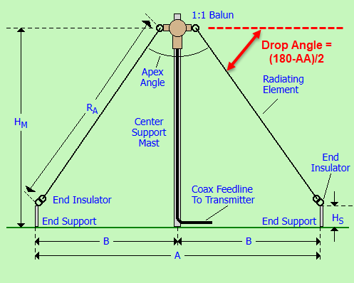
Model With Variables/Formulas (3)
Diagram taken from K7MEM.
Apex Height
Apex Angle
Drop Angle
Half Length (Ra)
80m: 3.525 MHz
#12 bare copper wire
K7MEM.com/Ant_Inverted-V.html

Slide 15
Model With Variables/Formulas (4)
Let’s start with an apex angle of 90 degrees.
Drop angle is 45 degrees.
Vee center at 0,0,H.
Let’s pick H = 50’.
What are the end points?
One side mirrors the other |-Y| = |Y|.
Some amount of high school trigonometry is often needed to compute end points.
Z
Y
H
X
45°
L
Z = H – (L sin 45°)
Y = L cos 45°
-Y = -(L cos 45°)
Y,Z
Z
Ground

Slide 16
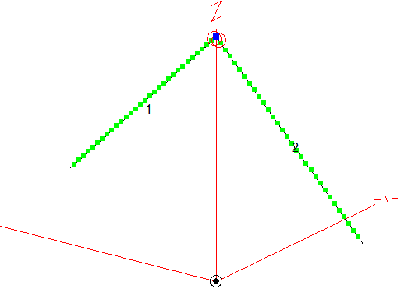
Model With Variables/Formulas (5)
In EZNEC, the Wires table is:
The Sources table is:

Slide 17
Model With Variables/Formulas (6)
Where did the length of the Wires (L) come from?
I started with a flat dipole of the approximate length and fiddled with the ends until I came close enough to resonance (X (reactance) = 0) at 3.525 MHz.
I used two EZNEC commands to rotate the two ends down by 45 degrees (drop angle).
Since this change shifted the resonant frequency a little bit, I again fiddled with the length to reestablish resonance.
I did not need, therefore, to work out the coordinates with pencil and paper like in the old days.
Took a few minutes and I didn’t break a sweat.
The result is an EZNEC inverted vee model as desired.

Slide 18
Model With Variables/Formulas (7)
AutoEZ presents nearly the identical tables as EZNEC, but now the spreadsheet cells can contain variables and formulas as well as numbers.
The tables have two modes: resulting numbers and input formulas that when evaluated lead to the numbers.
AutoEZ can read and write EZNEC format files as well as its own format (.weq). I read in my EZNEC model as a convenient starting point.
Here’s what the AutoEZ model looks like with variables and formulas.

Slide 19
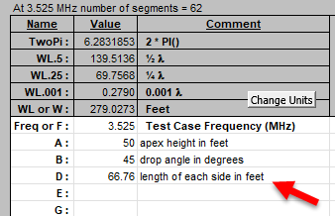
Model With Variables/Formulas (8)
The variables are the height, drop angle, and length.
The variables are specified on the Variables Excel sheet.
The initial length was taken from AutoEZ after loading the model from EZNEC.
Helpful values provided by AutoEZ

Slide 20
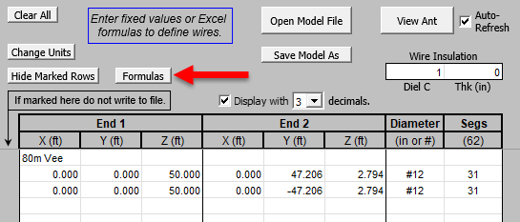
Model With Variables/Formulas (9)
The AutoEZ Wires sheet is similar to the EZNEC Wires window.
Note the Formulas button – clicking leads to:

Slide 21
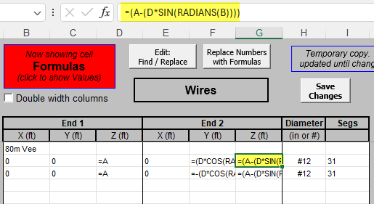
Model With Variables/Formulas (10)
Variables A, B, and D and the previous formulas are used to set the Y and Z coordinate values. Excel syntax.
We now have a parameterized model.
Switch to the Calculate sheet and Calculate All Rows.

Slide 22
Model With Variables/Formulas (11)
A few points to highlight:
Freq, R, X, SWR, slice max gain, pattern at slice, optional 3D results (RDF, AKA Directivity), optional Average Gain Test.
Yes, this is a cloud warmer!
This is all available in EZNEC, so what’s the big deal?
Now, we can Generate Test Cases….

Slide 23
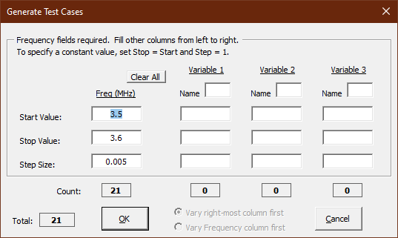
Model With Variables/Formulas (12)
A frequency span and up to 3 variables can be stepped through a range of values to investigate a design space.
Let’s start with 3.5 to 3.6 MHz with 5 KHz steps (21 total steps).

Slide 24
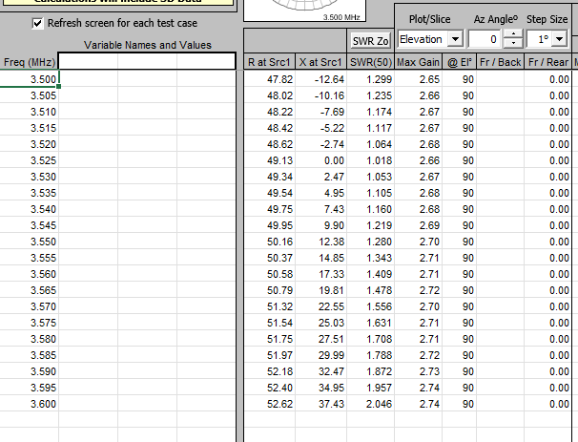
Model With Variables/Formulas (13)
EZNEC is run at the 21 frequency points and all of the data is collected for analysis in AutoEZ.
EZNEC does sweep SWR, but that’s it.
Move to the Pattern sheet.

Slide 25
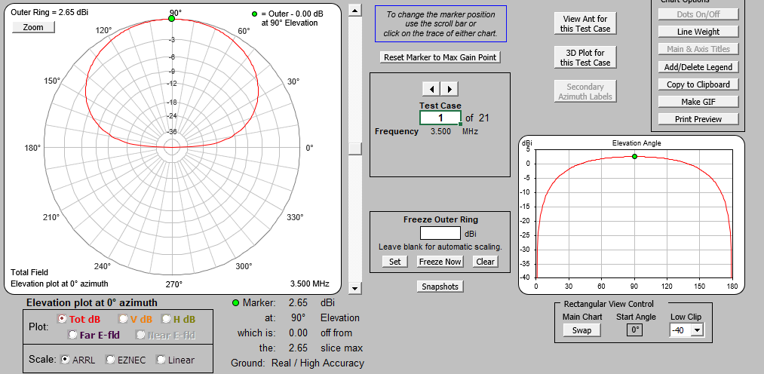
Model With Variables/Formulas (14)
Pattern slice analysis, including the ability to create labeled plots for the Clipboard and GIFs.

Slide 26
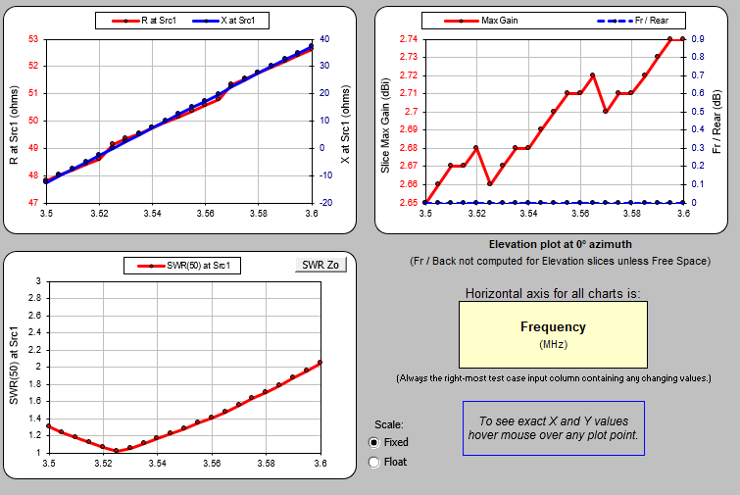
Model With Variables/Formulas (15)
This is the Triple sheet. R, X, SWR, and slice max gain as well as F/B and F/R.
There is also a Smith Chart sheet
(not shown).
It’s easy to label and save the graphs.

Slide 27
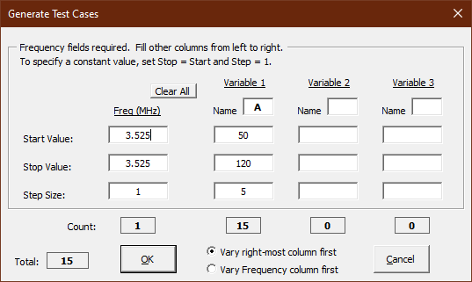
Model With Variables/Formulas (16)
Rather than vary the frequency, hold it constant at the target of 3.525 MHz and vary the apex height from 50 to 120 feet in steps of 5 feet.
A is the name of the apex height variable.

Slide 28
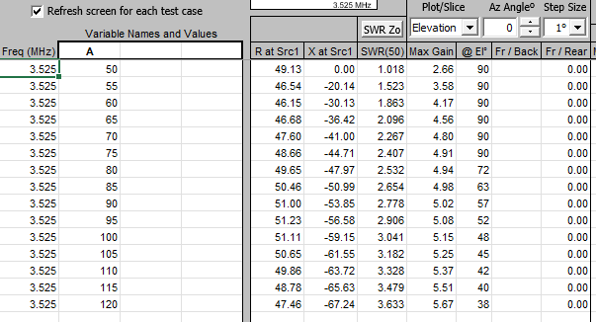
Model With Variables/Formulas (17)
Note the reduction in take-off angle as the vee moves higher.
The feed point impedance changes as the height changes.
What if I was thinking of putting the apex at 80’?
How would the length change to bring the vee into resonance?

Slide 29
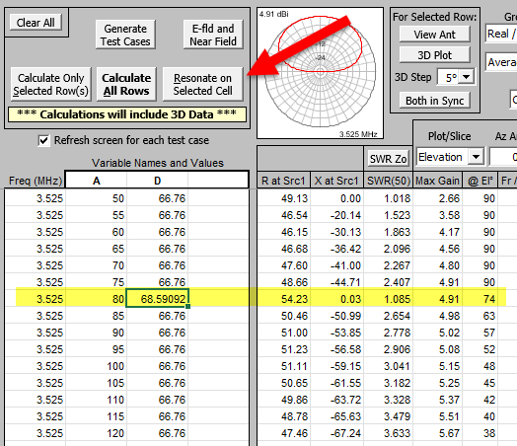
Model With Variables/Formulas (18)
By selecting the D variable cell at 80’ and clicking Resonate on Selected Cell AutoEZ will vary the value of D on that row until the reactance is driven to 0 Ohms.
For the 45 degree drop angle with an 80’ apex at 3.525 MHz each side of the vee is 68.59’ long.
SWR is 1.085.
AutoEZ did the fiddling.

Slide 30
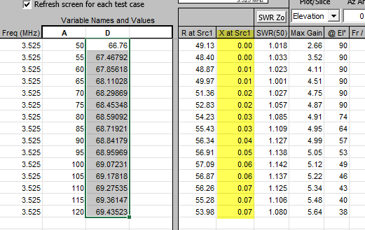
Model With Variables/Formulas (19)
In fact, I could select the whole D column and AutoEZ would run EZNEC to bring all lengths into resonance.
This was done with one click.

Slide 31
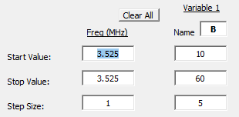
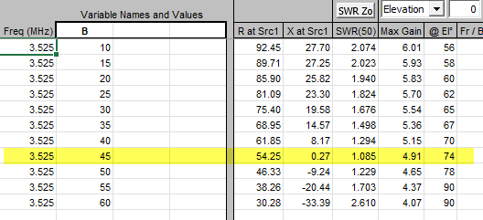
Model With Variables/Formulas (20)
Variables
Let’s say I wanted to explore the 80’ apex and vary the drop angle from 10 to 60 degrees?
Fix the height and length, vary the drop angle (variable B).
Generate
Results

Slide 32
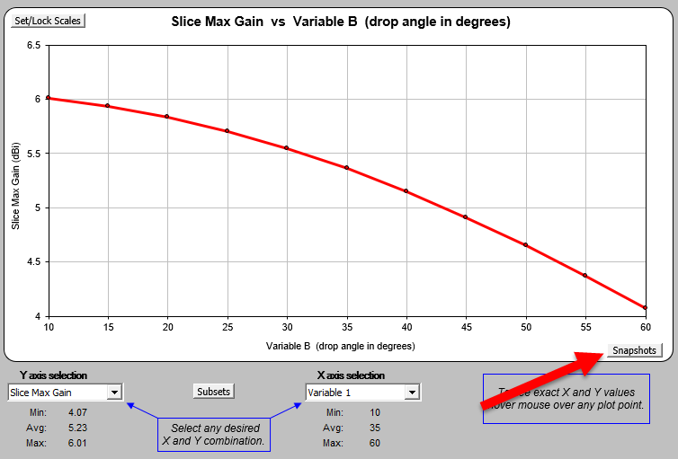
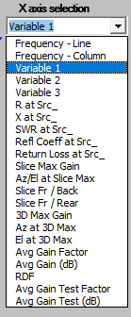
Model With Variables/Formulas (21)
X and Y axis
choices
The graph on the Custom sheet can be used to plot the max gain as a function of the drop angle.
This is at the 80’ apex.
The Snapshots button saves and compares different data sets.

Slide 33
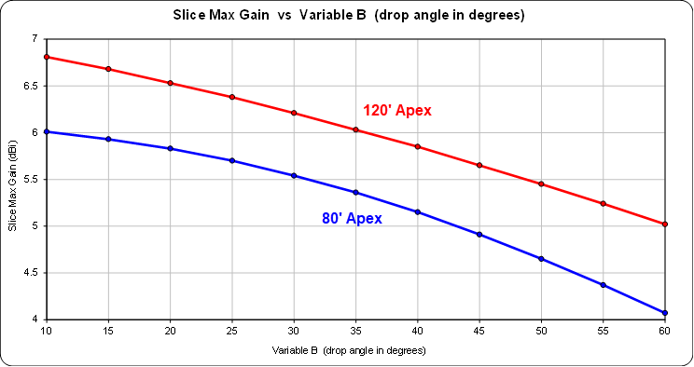
Model With Variables/Formulas (22)
Comparison of 80’ apex to 120’ apex as a function of drop angle using a Snapshot.

Slide 34
Optimize Models
Often more of an art than science.
Which makes it rewarding and fun and highly creative.
Optimize means to optimize something.
An initial design (starting point) is needed (not a blank piece of paper).
Optimize can mean maximum or minimum (e.g gain / SWR).
The Nelder-Mead simplex algorithm is used in AutoEZ.
Details on https://ac6la.com/aeoptimize.html
Additional information on the N-M Wikipedia page.
One of the pitfalls in optimization is getting trapped in a local minimum. Find a solution that looks good but is not the best one.
Exhaustive search optimization (brute force) can find the optimum solution, but usually is too costly (most design spaces have several variables and are insanely large).

Slide 35
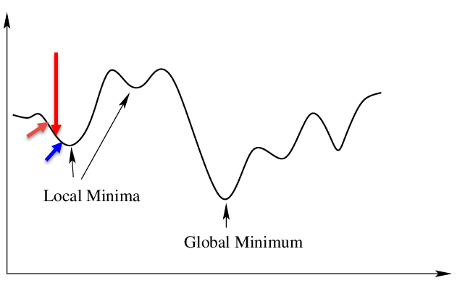
Optimize Models (2)
Consider a one-dimensional function:
The goal is to find the global minimum (or maximum).
Can’t solve with calculus!
A brute force method would evaluate every point along the X-axis and find the minimum.
This can take a lot of time/cost, especially if many dimensions.
Vitalflux.com
A less costly method might make a guess at the red arrow and then evaluate the points to the left and right and decide to move to the blue arrow as the next center point since it is lower.
Once the process starts to go higher, it could stop, declaring victory.
Unfortunately, it has found a local minima, not the global minimum.

Slide 36
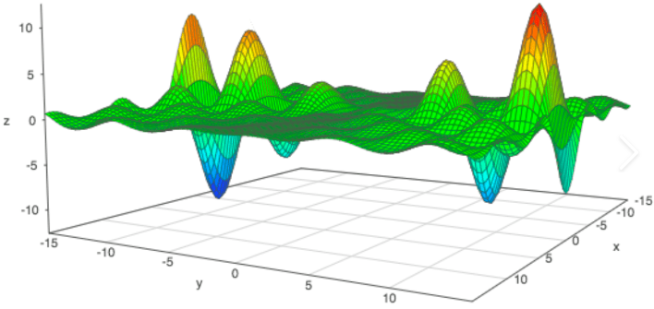
Optimize Models (3)
Even with only two-dimensions the terrain can get very complex.
3 axes, 2 dimensions.
A 5 element Yagi might have 9 dimensions.
The lengths of the 5 elements (dipoles).
The positions on the boom for 3-4 elements.
What if the goal is to maximize gain, reach a good enough SWR and good enough Front/Back ratio?
This is not a simple problem, and the design space is huge.

Slide 37
Optimize Models (4)
There are hundred of optimization algorithms.
Often, they are designed to exploit some known bit of information about the problem so that they have the best chance of avoiding getting trapped in a local minima and being fast.
Solving the problem is always easier when you understand the problem.
Dan, AC6LA, spent time testing different algorithms before settling on Nelder-Mead, which is well suited for problems with many dimensions.
Over the last 10+ years I have used the AutoEZ optimizer with around 20 Yagi designs, mostly OWA.

Slide 38
Optimize Models (5)
I was often starting with an existing OWA design – you must start with something. (OWA = Optimized Wideband Array)
They were the previous generation Yagi’s and the idea was to look to improve them with AutoEZ.
In several cases there were updated taper schedules for a higher wind rating – changing taper changes the dimensions.
Improvements were made, but generally small. ~0.5 dB, flatter SWR, etc.
Establishes that AutoEZ is in line and competitive with previous optimizers.
Did not get stuck in a never-ending loop.
Some local minima trapping.
Could find preposterous solutions that failed the Average Gain Test.
Avoid local minima traps by permuting and retrying - perhaps start in another valley.
Some designs took aound 700 runs of EZNEC and perhaps 20+ minutes. Small price to pay for a solid antenna design.

Slide 39
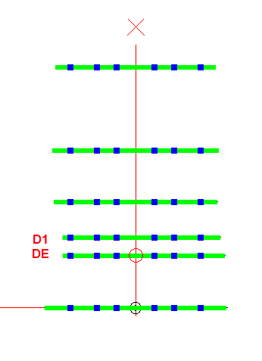
Optimize Models (6)
Don’t expect to get everything you want.
“There are no ideal solutions, only tradeoffs”.
Gain, Pattern shape, F/B, F/R, SWR, etc, all come with a price. Whack-a-mole.
Let’s look at a 6 element 20m OWA Yagi on a 48’ boom.
Coupled resonators formed by closely-spaced DE and D1 lead to a wide and low SWR response.
42 NEC Wires.

Slide 40
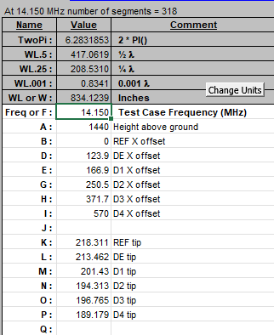
Optimize Models (7)
This is the Variables sheet.
Working in inches.
1440” = 120’ high.
13 variables, but only 10 are optimized.
Height above ground and the positions of the REF and D4 are fixed (boom is fixed).

Slide 41
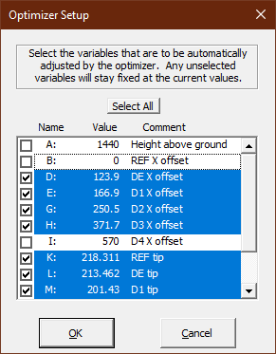
Optimize Models (8)
Use the Optimizer Setup button to select what Variables should be adjusted.
Unselected are fixed.

Slide 42
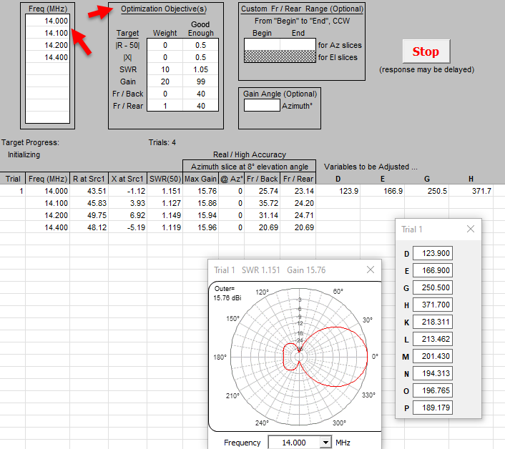
Optimize Models (9)
The Optimize sheet sets up and runs the optimization.
OWA is established by setting Frequency targets across the band.
Targets have weights.
Progress is updated in the table and pattern.

Slide 43
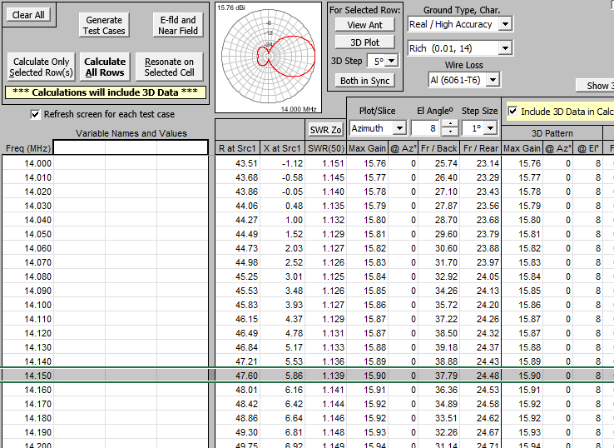
Optimize Models (10)
The Calculate sheet.

Slide 44
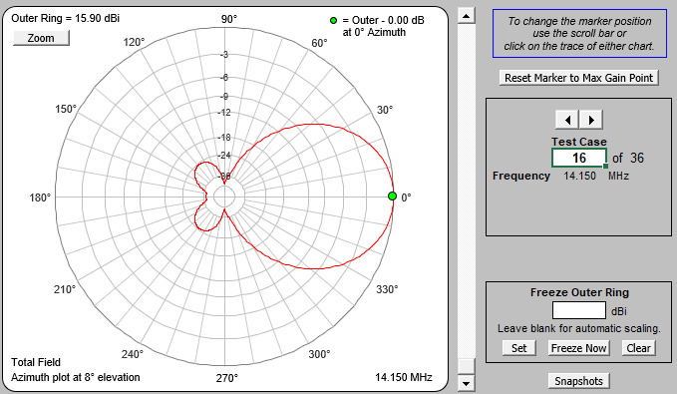
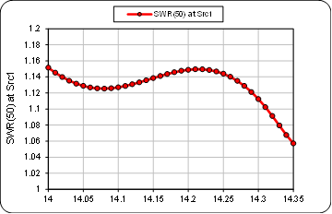
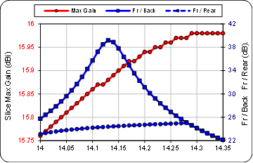
Optimize Models (11)
All the analysis tools previously presented are available.

Slide 45
Optimize Models (12)
SWR has increased value with solid state amps.
Using the AutoEZ optimizer is a good way to make use of an aluminum tubing boneyard.
Booms and elements from this and that.
Use software like YM (Yagi Mechanical) to determine taper schedules.
Determine wind speed ratings and ice loading limits.
Fix the locations of the reflector and front director to accommodate the boom length available and turn loose the optimizer to fill in the middle.
Congratulations, you are a Yagi designer!

Slide 46
AutoEZ Examples
The online documentation at ac6la.com is excellent and extensive.
https://ac6la.com/aecollectiontoc.html
Many examples of popular antennas and topics.
Examples include discussions, files, and references.
These can be very helpful even if you never model!
Most of the examples serve as practical lessons in modeling.
Reminds me of the work of L.B. Cebik, W4RNL (SK).

Slide 47
AutoEZ Examples (1)

Slide 48
Other Software/Notes by AC6LA
AutoEZ (this presentation!)
ZPlots (plot impedance data from many sources)
TLDetails (transmission line analysis)
XLGTa (antenna gain/temperature ratio > 70 MHz)
Feed2EL (2 element vertical array)
MoxGen (Moxon Rectangle generator)
Additional Loss Due to SWR (note)
Transmission Line Math (note)
And a few more….

Slide 49
ZPlots
Plots data versus frequency which can be computed from the complex reflection coefficient obtained from many sources, including models and measured.
Accepts the popular Touchstone® format (and .csv .data .txt).
Comparing antenna model expectations to measured results on a single graph simplifies evaluating the model/measured closeness.
The complex reflection coefficient (S11 scattering parameter) can be converted into many parameters, including: SWR, Rs, Xs, |Z|, RL, Q, Ls, Cs, etc (can be used with VNAs, not just antennas).
ZPlots is contained in an Excel file.
ZPlots can compare several sweeps on one graph.
Output can be a rectangular graph, table, or Smith Chart.

Slide 50
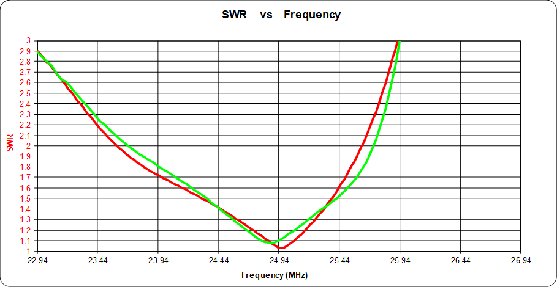
Zplots (2)
Comparison of 12m Yagi model (red) to measured (green).

Slide 51
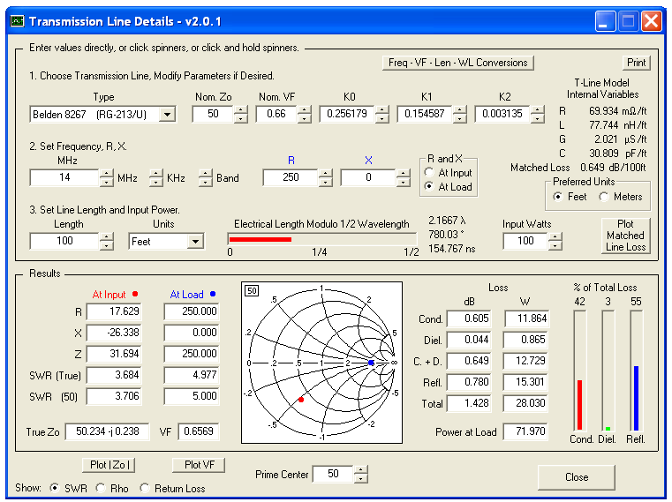
TLDetails
Determine the impedance transformation through a section of TL knowing either the load or input impedance.
Built-in detailed specifications for approximately 100 different line types (coax, open wire).

Slide 52
Conclusion
This is a great time to get into antenna modeling!
Very low cost for the top-of-the-line NEC tools.
NEC-4.2/5.0 + EZNEC Pro/2+ v. 7 + AutoEZ < $200.
Very high functionality and performance.
All of these tools updated in the last 5 years.
AutoEZ is in active development.
PCs are screaming fast these days.
Lots of examples and models out there.
NEC-5 appears to be most insensitive to a range of modeling guideline violations. NEC-5 is recommended by Roy, W7EL.

Slide 53
References
https://ac6la.com (AutoEZ Internet Home)
djm2150@yahoo.com (Dan’s email)
ordy@seed-solutions.com (my email)
Advanced Antenna Modeling by Marcel De Canck, ON5AU (SK): http://www.on5au.be/advanced_modeling_book.html
Practical Antenna Models vol.1-3 by ON5AU: http://www.on5au.be/practical-antenna-modeling.html
https://eznec.com/AutoEZ.htm
https://eznec.com/misc/EZNEC_Printable_Manual/7.0/EZW70_User_Manual.pdf
https://eznec.com/AutoEZ.htm
QRZ Antenna Forums: https://forums.qrz.com/index.php?search/129677990/&q=autoez&o=date&c[node]=33&c[user][0]=293912

Slide 54
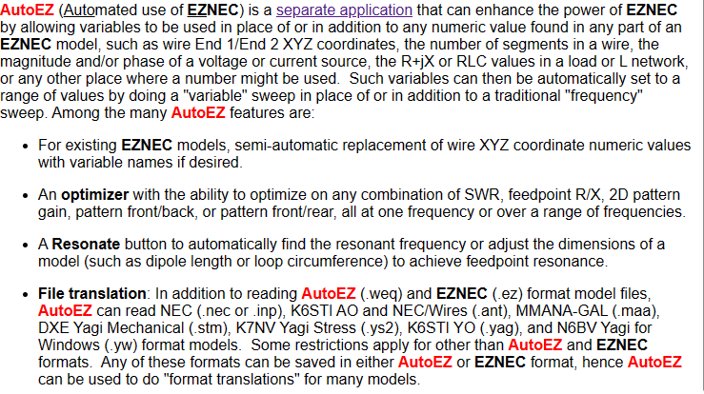
AutoEZ Feature Summary
Taken from the page: https://eznec.com/AutoEZ.htm

Slide 55
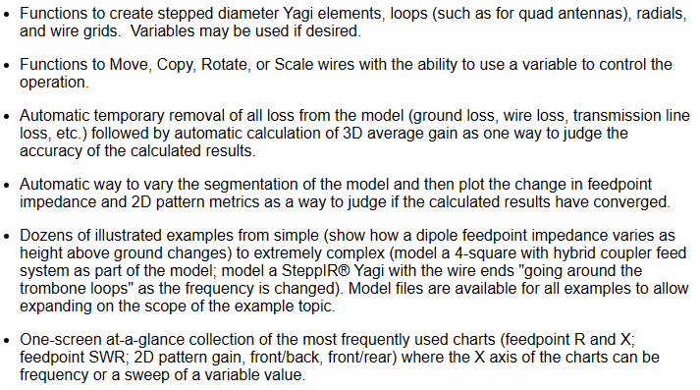
AutoEZ Feature Summary (2)
Taken from the page: https://eznec.com/AutoEZ.htm

Slide 56
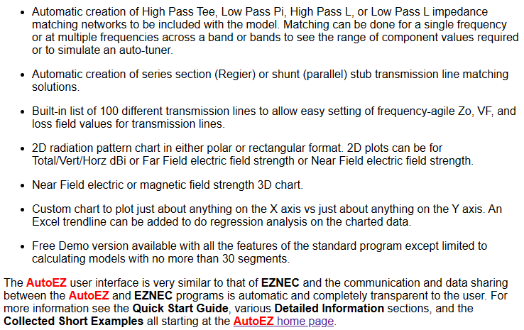
AutoEZ Feature Summary (3)
Taken from the page: https://eznec.com/AutoEZ.htm

Slide 57
EZNEC in 2024
Based upon reading the EZNEC web page:
https://eznec.com/ez70faq.htm
There are now two EZNEC products:
Pro/2+ and Pro/4+. Both are free. Both are version 7 in terms of features. This is the latest version.
The only difference between Pro/2+ and Pro/4+ is that Pro/4+ includes an internal NEC-4.2 engine, which will execute faster than the external 4.2 engine.
Only previous EZNEC Pro/4 customers qualify for Pro/4+ because W7EL verified your NEC-4 license as part of purchasing Pro/4.
New customers should download Pro/2+ and then purchase NEC-4.2 or NEC-5 licenses from LLNL as desired. Download engine after purchase.
Each is now $110.
Pro/2+ will work with external NEC-4.2 and 5 engines.
NEC-5 is only available as an external program engine.

Slide 58
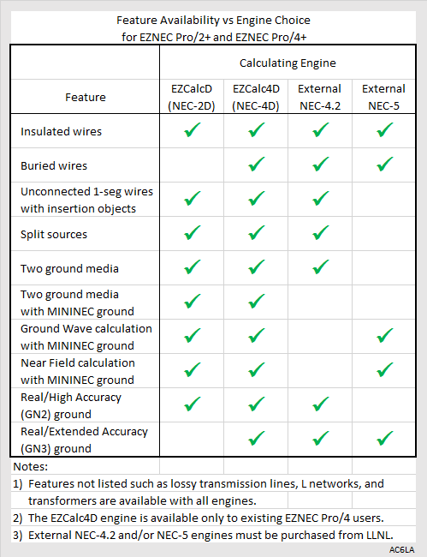
EZNEC Calculating Engines
Differences in calculating engines described on page 180 of the EZNEC 7.0.3 user manual.
Table prepared by Dan, AC6LA.

Slide 59
Bio of AC6LA
I asked Dan for any information about himself that he was willing to share. Here’s what he said:
I got into ham radio when I was a junior in high school. My Elmer was Mel, W3ZQU, a WWII radio op vet. He owned a TV repair shop (and sold Setchell Carlson TV sets) so obviously I was never at a loss for parts for home brew projects. He also happened to be the father of my high school girlfriend. My Novice call was WN3LVE and he used to tease me mercilessly that I was the only Novice he knew who wanted to upgrade to a 1x4 call, W3LOVE. The girlfriend didn't last. Ham radio did.

