Slide 1
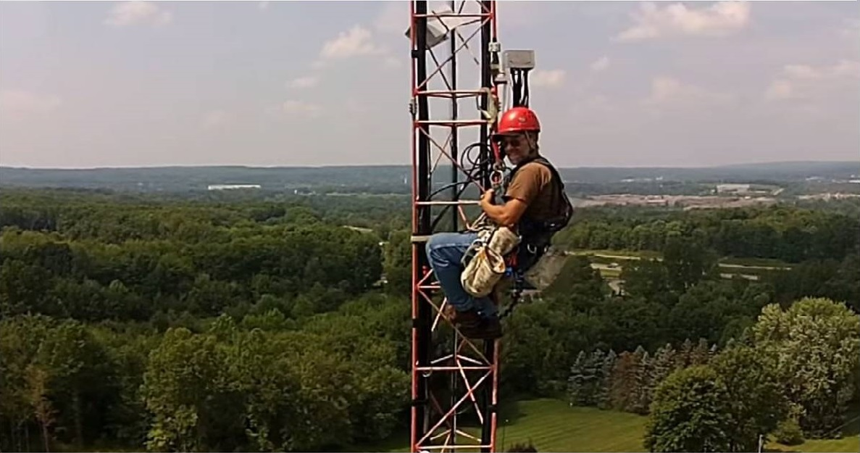
Tower Safety Tim Jellison W3YQ/KL7WV

Slide 2
Some disclaimers:
I am not a certified instructor.
You will not be a certified climber after this talk.
I am, however, a certified climber/rescuer.
My only goal is to help you stay safe.

Slide 4
The rules keep changing within the industry.
The keen observer will find discrepancies throughout this presentation. 4 feet? 6 feet?
The numbers are far less important than the concepts.

Slide 5
Don’t be mean to me. : (

Slide 6
Oh, and I HATE Powerpoint!

Slide 7
Italics stuff means it’s either happened to me or I know of it happening to someone. Maybe spend extra time thinking about those items???

Slide 8
Hazards
Electrocution
Check for powerlines before beginning work.
Dipoles, verticals, towers, Yagis, ropes.
They’re all conductive.

Slide 9
Hazards
Structural failure
Check all guy wires.
Check foundation.
Check for rust/degraded components.
Cheap hardware used?
Guyed towers need to be straight and plumb.
Install temporary guys when stacking or dismantling towers.

Slide 10
Hazards
Incapacitation
Know your body.
Heat/cold. Both can tap your strength.
Work slowly and methodically.
Insects and birds.

Slide 11
Hazards
Falls
Any fall could be fatal.
Even falling 10 feet could kill you.
100% tie-off. No free climbing. No exceptions.

Slide 12
100% Tie off. No free climbing!
Always use a full body harness.
It will keep you safe(r) and it will greatly assist the rescuer during a rescue.
I use a DBI Sala Exofit harness. But there are all kinds of approved options on the market.
None of it is cheap, however. But what’s your life worth?

Slide 13
Full Body Harness

Slide 14
Full Body Harness

Slide 15
Fall arrest and fall prevention are two different things.
We’ll talk about both as we progress.

Slide 16
Regulations
In the US, fall arrest for employees is mandated by OSHA. The requirements are further defined by ANSI.
OSHA has no jurisdiction over you working you are working in your own backyard. But that doesn’t mean you should be haphazard. Follow the rules anyway. They’re there for a reason.

Slide 17
OSHA rules are broad and cover all types of employees, not just tower workers.
OSHA mandates fall arrest devices be utilized for any work 6 or more feet up.

Slide 18
Types of Fall Arrest equipment
IMPORTANT
All fall arrest equipment attaches to the back, dorsal D-ring of your harness.

Slide 19
Full Body Harness

Slide 20
Double Fall Arrest Lanyards

Slide 21
Double Fall Arrest Lanyards

Slide 22
This is NOT a Fall Arrest Lanyard

Slide 23
Fall Arrest Equipment
The true, proper and safe methods of using fall arrest equipment is complicated and beyond the capabilities of this class. But we’ll do our best.
Using it improperly can be dangerous. And it might give you a false sense of security.
Taking a professional tower climbing class is highly recommended.

Slide 24
Fall Arrest Equipment
The forces exerted on your body during a fall will surprise you.
The tie-off point for your fall arrest equipment is critical.
And while (if used properly) the fall arrest equipment will save your life, you WILL be hurt.

Slide 25
Fall Arrest
Only attach to the back, dorsal D-ring.
Your attachment point must hold 4000 lbs.
Will it hold a pickup truck?

Slide 26
Double click on the box to play the video

Slide 27
After the fall
How will you get the (injured) climber down?
Be aware of suspension trauma.

Slide 28
Rescue Plan
High angle rescue techniques are taught in certification classes like Comtrain, but you probably won’t have the training or the equipment.
Soooo, it usually falls onto the local fire department to rescue you.

Slide 30
Interestingly, OSHA’s rules only address fall ARREST.
I advocate fall PREVENTION.

Slide 31
Different equipment which can be attached to your harness
Fall arrest equipment keeps you from going splat once you start to fall.
Positioning equipment keeps you from falling and, when used properly, it prevents a fall from even starting.
Practically speaking, you’ll be using positioning equipment – so you can do work.
This is not an either/or. It’s OK to use both.

Slide 32
Adjustable Positioning Lanyard

Slide 33
Positioning Device

Slide 35
If using a fall arrest lanyard, the tie-off point is critical. Don’t trust Rohn cross braces. They’re not strong enough.

Slide 36
Snap around the tower leg instead

Slide 38
Be careful at the top of the tower. Don’t let the lanyard slip over the top.

Slide 39
You can get a harness with a seat strap. These are the best!!!

Slide 40
Hardhats Required
Everyone wears one! The climber needs to have a chinstrap on his/hers.
Don’t stand around the base of the tower.

Slide 41
Cable Grab

Slide 42
A cable grab MUST be attached to the front sternal D ring.

Slide 43
Using man lifts and cranes cost you some $, but they’re a good way to do tower work. And do it safely.
When using a man lift or a man basket hung from a crane, a full body harness with fall arrest lanyard MUST be used.

Slide 44
Never, ever, ride on a rope!!!

Slide 51
Some Tidbits
Consider using a boom truck or crane to install antennas.
Sign companies often have boom trucks.
Man lifts are a good way to go. You still need full harness and fall arrest equipment when going up in one.
A crane with a man basket sometimes saves the day when repairing an antenna. Again, full harness and fall arrest equipment is required.

Slide 52
More Tidbits
Rock climbing gear works well for rigging light loads. But it’s not suitable for climber-safety purposes.
Anything (carabineers, lanyards) should be ANSI Z359 rated. Rock climbing gear is NOT rated and should never be used for human loads when working on a tower.

Slide 53
Plumbing a tower
Use two transists 90 degrees apart.
You can also drop a weighted string into a
bucket of water.

Slide 54
If hiring a tower crew, use only certified climbers
Consider becoming a certified climber yourself
www.comtrainusa.com www.citca4training.com

Slide 55
And above all, when climbing follow all safety rules!
NO SK’s

