Slide 1
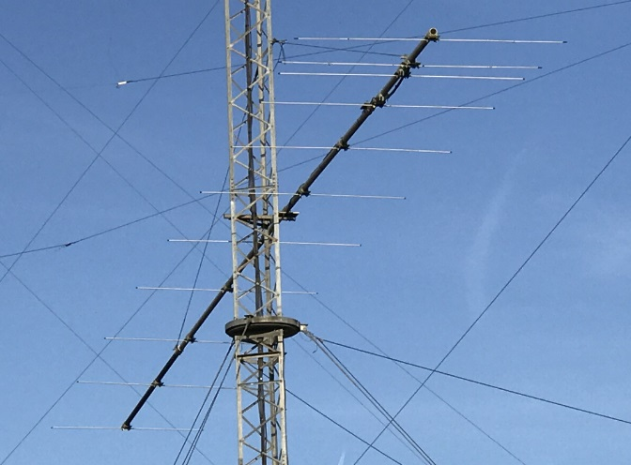
Selecting, Constructing,
Operating and Maintaining
High Performance 6 Meter Yagis
11 element
6 meter Yagi
50 feet high
at W3LPL
Frank Donovan
W3LPL
donovanf@erols.com

Slide 2
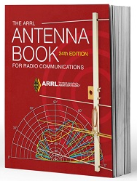
The Most Valuable Investment for any Antenna Builder
home.arrl.org/action/Store/Product-Details/productId/114288

Slide 3
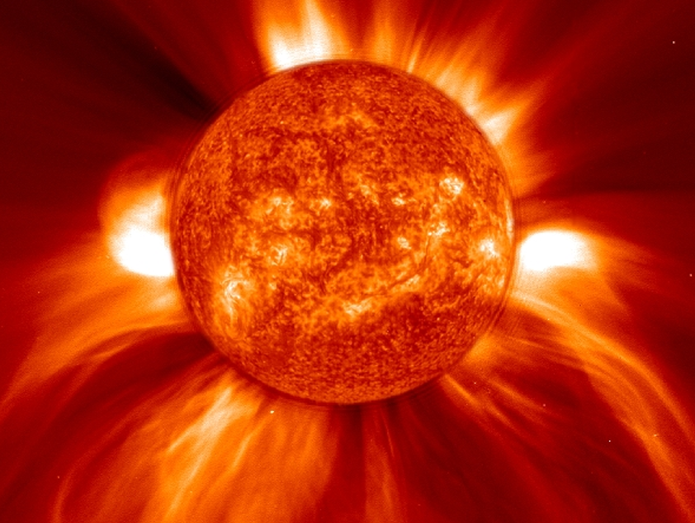
Forget Everything You
Know about HF Propagation
6 Meter Mid-Latitude
Sporadic-E (E_{s}) Propagation is Fundamentally Different

Slide 4
Northern Hemisphere 6 Meter Mid-Latitude E_{s} Propagation
This presentation focuses exclusively on
northern hemisphere 6 meter mid-latitude E_{s} propagation
- E_{s} as used in this presentation always refers only to
northern hemisphere 6 meter mid-latitude E_{s} propagation
Southern hemisphere 6 meter mid-latitude E_{s} propagation is very similar in almost all respects
- it has unique characteristics not covered in this presentation
Two other common forms of 6 meter E_{s} propagation have
important unique characteristics not covered in this presentation
- equatorial E_{s} every day near the geomagnetic equator
- auroral-E (auroral-E_{s}) only during severe geomagnetic storms
Antenna recommendations in this presentation fully apply
to most forms of 6 meter long distance propagation:
- TEP, F₂, FAI, meteor scatter and meteor showers
- ideal antennas for auroral and iono-scatter are slightly different

Slide 5
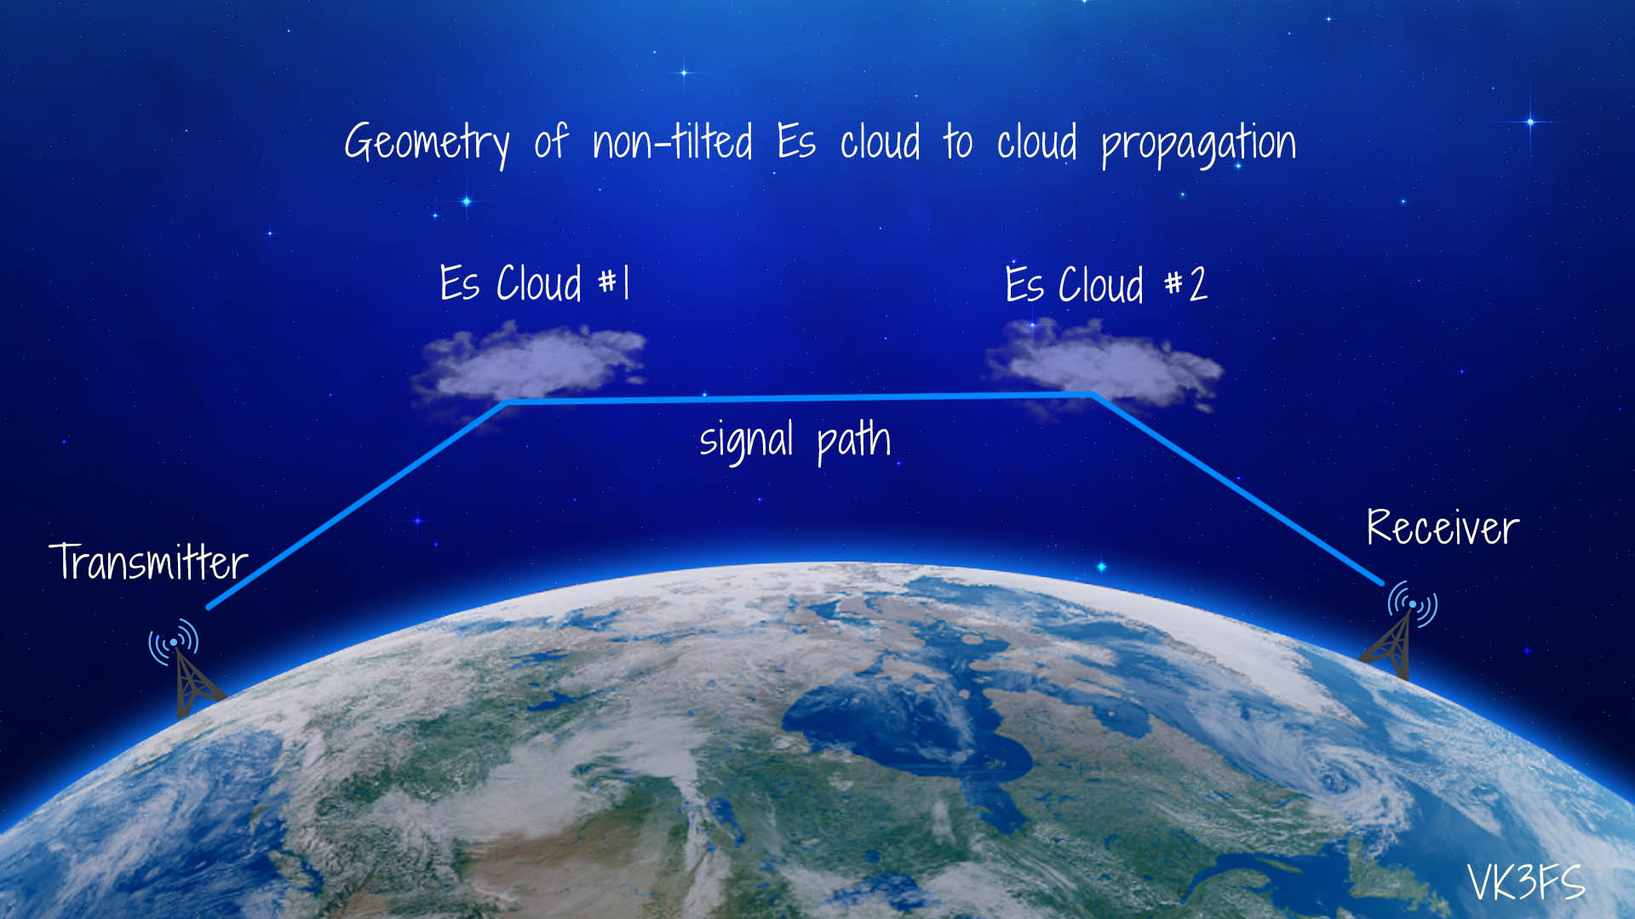
Mid-Latitude E_{s} Propagation Below the MUF propagation 800 to 1200 km Near the MUF propagation 1200 to 2000 km Above the MUF propagation 2000 to 10,000+ km
Multiple irregularly spaced thin, dense, small, localized E_{s} patches
Above the MUF
Above
the MUF
chordal hop
Above
the MUF
chordal hop
Sporadic-E Patch
Sporadic-E Patch
Elevation angle
usually below 8º
Above
the MUF
Near the MUF
Below
the MUF
50 ft high
Yagi
Receiver
Newfoundland
2000 km
Maine 800 km
Europe and Asia
4500 to 10,000+ km
Maryland

Slide 6
Single Hop E_{s} Propagation By far the most common E_{s} propagation
Usually about 1500 to 2000 km (1000 to 1200 miles) Occasionally about 800 to 2400 km (500 to 1500 miles)
Very efficient below and near the MUF reflection from
a thin (about 1 to 2 km thick), small (about 100 km wide or less)
dense, localized E_{s} ionization patch
about 100-110 km (65 miles) above the Earth
Elevation angle usually below 8º
Near the MUF
Below the MUF
Receiver
50 ft high
Yagi
Georgia1000 km
Cuba
2000 km
Maryland

Slide 7
Double Hop E_{s} Propagation Usually about 2800 to 4000 km (1600-2400 miles) Sometimes as short as 2200 km (1400 miles)
Two localized, irregularly spaced, irregularly shaped E_{s} patches
Sporadic-E Patch
Sporadic-E Patch
Elevation angle
usually below 5º
50 ft high
Yagi
Receiver
Kansas
2000 km
California
4000 km
Maryland
Lossy
intermediate ground reflection

Slide 8
Above-the-MUF Partial Reflections via Chordal Hops between E_{s} Patches 2000 km (1200 miles) to 10,000+ km (6000+ miles)
Multiple localized, irregularly spaced, irregularly shaped E_{s} patches
Elevation angle
usually below 5º
One or more chordal hop(s)
50 ft high
Yagi
Receiver
No (or few)
lossy intermediate ground reflections
Hawaii
Europe
Africa
Asia
Maryland
E_{s} ionization patches are often capable of efficient above-the-MUF partial reflection at higher frequencies than reflections returning to Earth
Partial reflections may propagate between two or more E_{s} ionization patches via chordal hops with no lossy intermediate ground reflection

Slide 9
Why is Mid-Latitude E_{s} Very Different? High temperature ablation ionizes the daily influx of many tons of metallic meteoroid dust. Vertical wind shears and tidal winds concentrate the ions into thin dense patches. Electrons move to the ions along magnetic field lines, forming E_{s} patches
Electrons can move only along magnetic field lines
Seasonally varying diurnal high altitude westerly winds
a few km above the diurnal easterly winds
Wind shears
High temperature ablation of
tons of metallic meteoroids
Thin dense
patches of ions
and electrons in the wind shear null
Wind shear null
Wind shears
Seasonally varying diurnal high altitude easterly tidal winds
at about 95 to 110 km altitude
Receiver
Tidal winds
Travelling ionospheric disturbances (TIDs)
Tidal wind variability:
minutes to hours
12 hours
24 to 48 hours
many days
seasonal
Tidal winds
Travelling ionospheric disturbances (TIDs)
Ionosphere D Region
50 to 95 km altitude
Ionosphere D Region
50 to 95 km altitude
researchgate.net/publication/227207773_A_Tutorial_Review_on_Sporadic_E_Layers

Slide 10
Observed 12 Hour Variability of June-July E_{s} Patch Occurrence at 50-55º North Latitude
40
115
Daytime E_{s} patches
Evening E_{s} patches
35
dawn
5 pm
110
30
7 am
6 pm
8 am
8 pm
25
105
9 am
E_{s} Occurrence rate (%)
Altitude - km
10 pm
20
10 am
100
15
11 am
noon
95
10
midnight
1 pm
3 pm
4 pm
midnight
xx
5
Dense D region below 95 km
0
3
6
9
12
15
18
21
24
Local time at the E_{s} ionization patch
12 hour variability of June-July E_{s} occurrence is caused by
downward drift of high altitude winds towards the D region
E_{s} is most frequent between 7 a.m and 1 p.m. local time
Image credit: GFZ German Research Centre for Geosciences

Slide 11
Increased Meteor Count at Northern Latitudes from Mid-May to Mid-August Correlates to increased E_{s} Vertical Incidence Critical Frequency
5.0 MHz
8000
4.5 MHz
4.0 MHz
6000
Average Daily
Vertical Incidence Critical Freq F_{o}E_{s}
Average Daily Meteor Count
3.5 MHz
4000
3.0 MHz
2.5 MHz
2000
Jan
Mar
May
Aug
Oct
Dec

Slide 12
Unlike rapidly recombining atmospheric ions, heavy metallic ions ablated from meteoroids
recombine very slowly in the thin E region
and persist for many hours to a day or more
after the 4 to 8 a.m. peak meteoroid influx
The optimum time for meteor scatter
from ionized meteor trails in the E region
is at about 4 to 8 a.m. local time when
your sunrise faces the incoming meteor influx
6
Facing away from the meteor
influx near your local sunset
Normalized Meteor Count Rate
Normalized Meteoroid Count Rate
5
4
3
2
0
6
12
18
24
12
Local time at your location

Slide 13
Easily Observable Basic Characteristics of Mid-Latitude E_{s} Propagation
Typical propagation Several thousand square miles
ground footprint to about ten thousand square miles or more
MUFs >50 MHz MUFs every day in June and July
-- but not everywhere and every day --
4000 to 10,000+ km Many days during June and July
E_{s} propagation - a few days in late May and early August
- a few days in late December/early January
Preferred antenna 3 to 6 (or more) element Yagi
Preferred polarization Horizontal polarization is strongly preferred
Preferred heights 50 to 60 feet high (70 feet only for DX)
Compromise height 25 feet high: about 3 dB worse at 1000 km
can be degraded by about 6 dB worse at 2000 km
dense housing and compared to 50 foot height
dense forests within 1000 feet

Slide 14
Easily Observable Extreme Variability of Mid-Latitude E_{s} Occurrence and Patch Locations
Monthly peak Every day during June and July
occurrence - but not everywhere and every day
Many days in late May and early August Some days in December, January and April
Uncommon from late January to early March
Daily maximum 7 a.m. to noon local time at the E_{s} patch
E_{s} occurrence rate during June and July
Daily peak 6 a.m. to 3 p.m. and 6 p.m. to midnight
E_{s} occurrence rate local time at the E_{s} patch during June and July
Short term Seconds, minutes and hourly variability
E_{s} patch drift Typically drift northward at up to 100 mph
E_{s} patch locations Seconds to minutes to hourly variability
Day-to-day Extreme day-to-day patch location variability
Day-to-evening Extreme day-to-evening location variability

Slide 15
Optimum Antenna Heights
and Elevation Angles
for 6 Meter E_{s} Propagation
(thanks K9LA)
Antenna Elevation Angles | Single Hop E_{s} Distance | RequiredF_{o}E_{s} (MHz) | Approx E_{s} MUF (MHz) | Optimum Antenna Height
Below 5º | 1400-2300 km | 9-10 | 45-50 | 70 feet
5º to 8º | 1200-1400 km | 10-11 | 50-55 | 50 feet
8º to 12º | 800-1200 km | 11-13 | 55-65 | 25 feet
12º to 15º | 700-800 km | 13-15 | 65-75 | 17 feet
Occurrence
Frequent
Very Frequent
Not Frequent
Rare
E_{s} MUF infrequently exceeds 60 MHz, limiting E_{s} elevation angles to below 8º
Multi-hop and chordal hop E_{s} occur most frequently at elevation angles below 5º
Yagis higher than about 100 feet are much too high for almost all E_{s} propagation
Few QSO partners have antennas with useful response below about 3º elevation
https://k9la.us/Jul18_Elevation_Angles_Required_for_6m_Sporadic_E.pdf

Slide 16
Horizontal Polarization
Provides up to 6 dB
of “free” ground reflection gain
Vertical polarization provides negligible ground reflection gain
4 to 6 dB of ground reflection gain is routinely achieved
by a horizontally polarized 6 meter antenna unless there:
- are many tall buildings in front of the antenna
- is a dense forest of tall trees in front of the antenna
- is extremely irregular terrain in front of the antenna
Just a few dB of ground reflection gain is rarely achieved
by vertically polarized 6 meter antennas
Horizontal polarization significantly reduces RFI
6 meter RFI sources tend to be vertically polarized

Slide 17
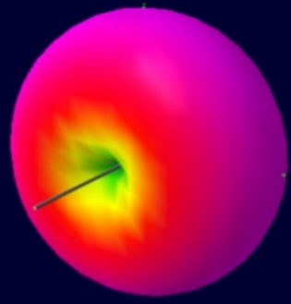
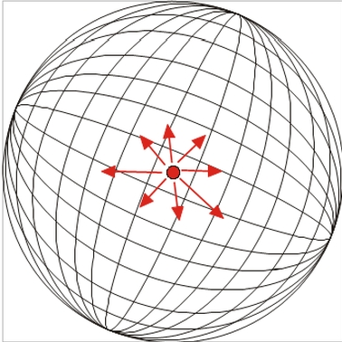
The Reference Antenna
for Yagi Antenna Gain (dBd)
in this Presentation is the
Half Wavelength Dipole in Free Space
Half Wavelength Dipole
in free space
Theoretical Isotropic Radiator
A half wavelength dipole in free space has 2.15 dB gain over an isotropic radiator

Slide 18
Elevation Pattern and Ground Gain
5 element 6 meter horizontal Yagi 50 ft high Excellent height for almost all E_{s}
Degraded by dense housing within 2000 ft
(roughly more than one house per acre)
d
>20º angles
not usable for E_{s}
rarely useful at ~700-1000 km
15º elevation angle
3 dB gain at ~1200 km
8º elevation angle
6 dB gain at ~1500 km
5º elevation angle
low angle lobe
3 dB gain at ~1800 km
3º elevation angle
EZNEC elevation pattern
-5 dB

Slide 19
Elevation Pattern and Ground Gain
5 element 6 meter horizontal Yagi 70 ft high
1 to 2 dB better for E_{s} DX than 50 feet high
Only minor degradation by dense housing
Unwanted deep null at 6º to 10º elevation
d
high angles not usable
for E_{s}
>20º angles
not usable for E_{s}
rarely useful at ~800-900 km
12º elevation angle
3 dB gain at ~1400 km
6º elevation angle
6 dB gain at ~1700 km
4º elevation angle
FIRST FRESNEL ZONE
low angle lobe
3 dB gain at ~2000 km
2º elevation angle
EZNEC elevation pattern
-5 dB
-5 dB

Slide 20
Elevation Pattern and Ground Gain
5 element 6 meter horizontal Yagi 25 ft high
Adequate height if you can’t go higher
Only 3 to 6 dB worse than 50 foot height
Degraded by dense housing within 1000 feet
(roughly more than one house per acre)
d
>20º angle
not usable for E_{s}
3 dB gain at ~800 km
12º elevation angle
6 dB gain at ~1000 km
10º elevation angle
low angle lobe
zz
3 dB gain at ~1500 km
5º elevation angle
EZNEC elevation pattern
-5 dB

Slide 21
Elevation Pattern and Ground Gain
5 element 6 meter horizontal Yagi 100 ft high
Too high for almost all E_{s} propagation
Unwanted deep null at 4º to 7º elevation
d
>20º angles
not usable for E_{s}
rarely useful at 700-1000 km
14º elevation angle
3 dB gain at ~1500 km
4º elevation angle
6 dB gain at ~1800 km
3º elevation angle
x
low angle lobe
EZNEC elevation pattern
-5 dB
3 dB gain at ~2100 km
1º elevation angle

Slide 22
Front to Rear (F/R) Ratio
d
Maximum signal from the rear
of the antenna
Maximum signal from the front
of the antenna
rear
front

Slide 23
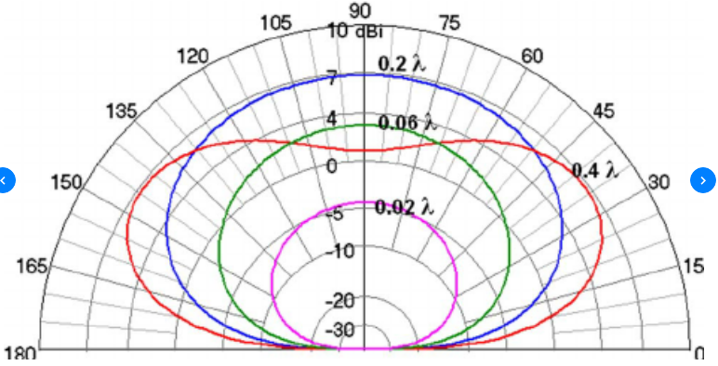
6 dBd Ground Gain of a Horizontal 1/2 Wave Dipole with
Only Minor Irregularities in the Reflection Zone
Terrain irregularities: <25% of antenna height
Dense housing: <25% of antenna height
Dense forest: <25% of antenna height
Obstructing less than 5% of the reflection zone
dBi
dBi
dBi
A horizontal half wave dipole at least 0.5 wavelength high with relatively smooth terrain and few tall buildings in the reflection zone has 6 dBd gain over a horizontal dipole in free space

Slide 24
The Classic “Image Antenna” Model
an accurate model
for computing peaks and nulls
in antenna elevation patterns
But it assumes an ideal ground reflection
with no obstructions and no irregular terrain
DIRECT RAY
IN-PHASE REFLECTED RAY
.
.
.
.
.
.
.
.
.
SINGLE POINT GROUND REFLECTION
WITH NO OBSTRUCTIONS
AND NO IRREGULAR TERRAIN
IMAGINARY
IMAGE ANTENNA

Slide 25
What is the Actual Reflecting Zone
in front of my antenna?
It definitely is not just a single point!
DIRECT RAY
MANY REFLECTED RAYS
How far in front of my antenna is the reflection zone?
How long is the reflection zone?
How wide is the reflection zone?
How much do obstructions degrade ground reflection gain?
How much does irregular terrain degrade ground reflection gain?

Slide 26
The Fresnel Zone
By definition includes all ground reflections
within +/- 90º of the phase of the direct ray that
add to the power from the direct ray if ground
reflections are not obstructed or absorbed
DIRECT RAY
ONLY ONE REFLECTED RAY
IS EXACTLY IN-PHASE
WITH THE DIRECT RAY
FRESNELZONE
EDGE
+6 dB
ground gain
0 dB
ground gain
0 dB
ground gain
https://ia801604.us.archive.org/5/items/sitingcriteriafo139utla/sitingcriteriafo139utla.pdf

Slide 27
The Fresnel Zone
Unobstructed 0º to 45º phase shifted reflections from roughly the middle half of the Fresnel zone contribute more power to low angle radiation than the 45º to 90º phase shifted reflections
from roughly the outer half of the Fresnel zone
DIRECT RAY
d
45º PHASE SHIFTED REFLECTED RAYS
IN-PHASE REFLECTED RAY
FRESNEL
ZONE
EDGE
90º PHASE SHIFTED REFLECTED RAYS
+6 dB
+0 dB
+0 dB

Slide 28
+3 to +6dB Ground Reflection Zone
is roughly in the middle half of the Fresnel zone
Ideally the reflection zone should not be obstructed by
- tall buildings and forests occupy < 5% of the zone
- buildings and forests are < 25% of antenna height
- irregular terrain < 25% of antenna height
DIRECT RAY
IN-PHASE REFLECTED RAY
+0 dB
+3 dB
+3 dB
+0 dB
+6 dB
Roughly the middle half of the Fresnel zone
forms the -3 dB contour of the antenna’s low angle lobe

Slide 29
+3 to +6dB Ground Reflection Zone
6 meter horizontal Yagi 50 feet high
5º elevation angle
DIRECT RAY
d
IN-PHASE REFLECTED RAY
+0 dB
+3 dB
+3 dB
+ 0 dB
+6 dB
~200 ft
~150 ft
+3 to +6 dB
reflection zone
~2000 ft

Slide 30
+3 to +6dB Ground Reflection Zone
6 meter horizontal Yagi 70 feet high
4º elevation angle
DIRECT RAY
d
IN-PHASE REFLECTED RAY
+0 dB
+3 dB
+3 dB
+0 dB
+6 dB
~250 ft
~200 ft
+3 to +6 dB
reflection zone
~2500 ft

Slide 31
+3 to +6dB Ground Reflection Zone
6 meter horizontal Yagi only 25 feet high
10º elevation angle
DIRECT RAY
d
IN-PHASE REFLECTED RAY
+0 dB
+3 dB
+3 dB
+0 dB
+6 dB
~100 ft
~25 ft
+3 to +6 dB
reflection zone
~1000 ft

Slide 32
5º Sloping Terrain in the Reflection Zone
6 meter horizontal Yagi 25 feet high
~100 ft of sloping terrain over ~1000 ft
5º elevation angle
DIRECT RAY
d
IN-PHASE REFLECTED RAY
+0 dB
+3 dB
~100 ft
+6 dB
+3 dB
+0 dB
~25 ft
+3 to +6 dB
reflection zone
~1000 ft

Slide 33
High Performance Short Yagis Light weight and small wind area Yagis Gain and front-to-rear ratio Source: VE7BQH charts (December 13, 2021)
Type Elements Gain Front to Boom Cost dBd Rear Ratio Length
M2 6M3 3 6 13 dB 7 ft $299
EAntenna 50LFA4 4 7 21 10 $260
Directive Sys JX5-50 5 8 17 13 $240
YU7EF EF0605C 5 8 24 14 -
G0KSC 4.4m 5LFA 5 8 19 14 $225+
EAntenna 50LFA5 5 8 21 14 $300
www.dxmaps.com/ve7bqh6.html

Slide 34
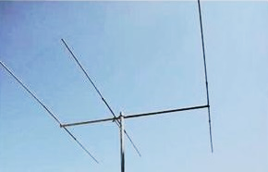
M2 6M3 Lightweight Yagi 3 Element T-matched Yagi 7 Foot Boom 6 Pounds 6 dBd Gain 13 dB F/R Ratio
www.m2inc.com/content/PDF%20MANUALS/6MANTS/6M3MAN03-W.pdf

Slide 35
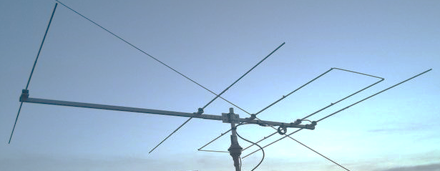
EAntenna 50LFA4 4 Element Loop Fed Yagi 10 Foot Boom 13 Pounds 7 dBd Gain 21 dB F/R Ratio
www.dxengineering.com/parts/ean-r2010106

Slide 36
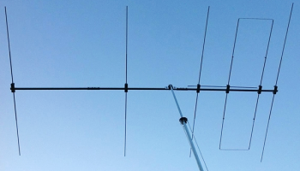
EAntenna 50LFA5 5 Element Loop Fed Yagi 14 Foot Boom 17 Pounds 8 dBd Gain 21 dB F/R Ratio
www.dxengineering.com/parts/ean-r2010102

Slide 37
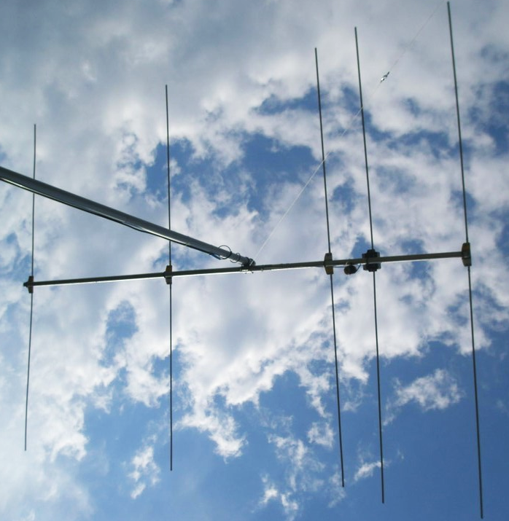
YU7EF EF0605C 5 element split dipole feed Yagi 14 Foot Boom 17 Pounds 8 dBd Gain 24 dB F/R Ratio
www.yu7ef.com/ef0605c.htm

Slide 38
G0KSC 5LFA 5 Element Loop Fed Yagi 14 Foot Boom 13 Pounds 8 dBd Gain 19 dB F/R Ratio
www.g0ksc.co.uk/50mhz-lfa-yagis/5el-44mtr-boom-lfa.html

Slide 39
Higher Performance Long Yagis Significantly improved front-to-rear ratio Gain and front-to-rear ratio Source: VE7BQH charts (December 13, 2021)
Type Elements Gain Front to Boom Cost
dBd Rear Ratio Length
G0KSC 6.2m 6LFA 6 9 30 dB 21 ft $406+
Innov 6.83m 6LFA 6 10 27 22 $447+
EAntenna 50LFA6 6 10 27 23 $460
G0KSC 8.9m 7LFA 7 11 25 29 $554+
EAntenna 50LFA7 7 11 26 31 $500
M2 6M7JHV 7 11 21 31 $525
Innov 8LFA 8 11 29 39 $812+
www.dxmaps.com/ve7bqh6.html

Slide 40
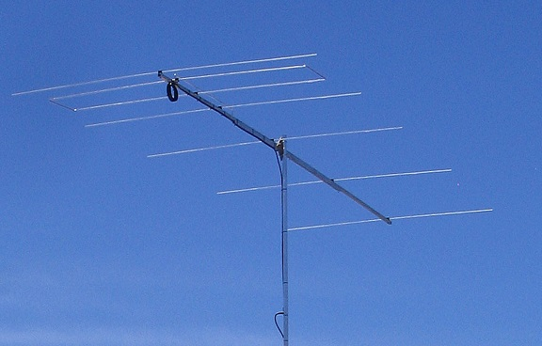
G0KSC 6LFA 6 Element Loop Fed Yagi 21 Foot Boom 14 Pounds 9 dBd Gain 30 dB F/R Ratio
www.g0ksc.co.uk/50mhz-lfa-yagis/6el-64mtr-boom-lfa.html

Slide 41
InnovAntennas 6.83m 6LFA 6 Element Loop Fed Yagi 22 Foot Boom 14 Pounds 10 dBd Gain 27 dB F/R Ratio
www.g0ksc.co.uk/50mhz-lfa-yagis/6el-64mtr-boom-lfa.html

Slide 42
Eantennas 50LFA6 6 Element Loop Fed Yagi 23 Foot Boom 30 Pounds 10 dBd Gain 27 dB F/R Ratio
www.dxengineering.com/parts/ean-r2010108

Slide 43
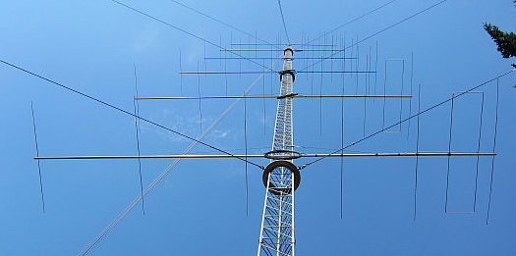
G0KSC 8.9m 7LFA 7 Element Loop Fed Yagi 29 Foot Boom 33 Pounds 11 dBd Gain 25 dB F/R Ratio
W7EW 180 foot tower
www.g0ksc.co.uk/7el-low-noise-lfa.html

Slide 44
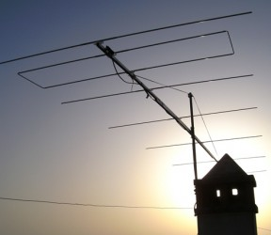
Eantennas 50LFA7 7 Element Loop Fed Yagi 31 Foot Boom 50 Pounds 11 dBd Gain 26 dB F/R Ratio
www.dxengineering.com/parts/ean-r2010111

Slide 45
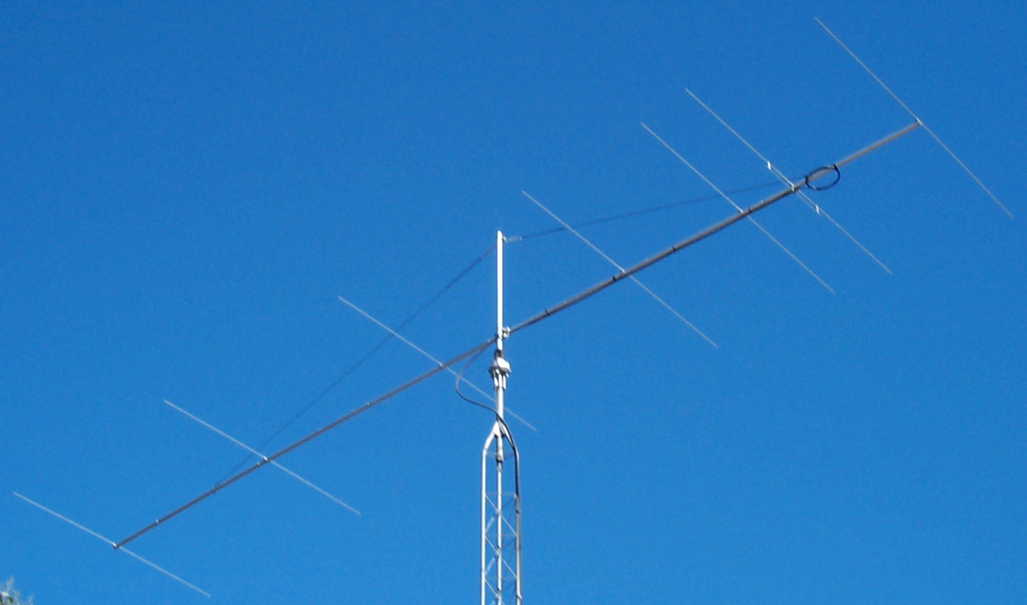
M2 6M7JHV 7 Element T-matched Yagi 26 Foot Boom 18 Pounds 11 dBd Gain 21 dB F/R Ratio
static.dxengineering.com/global/images/instructions/msq-6m7jhv.pdf

Slide 46
InnovAntennas 8LFA 8 Element Loop Fed Yagi 38 Foot Boom 40 Pounds 11 dBd Gain 29 dB F/R Ratio
JA1BK
innovantennas.com/en/shop-page/190/3/vhf-uhf-ham-radio-antennas/50mhz-yagis-all/8-element-50mhz-lfa2-yagi-11-67mInnovAntennas%20shop.html

Slide 47
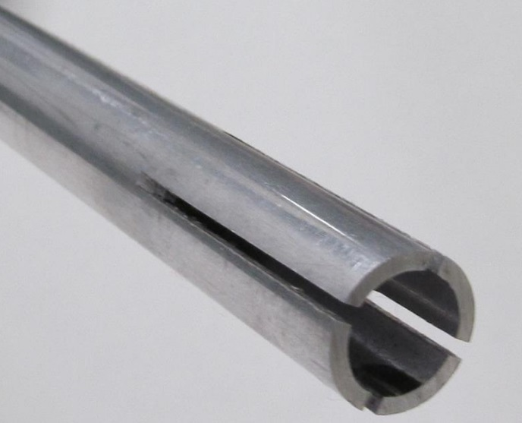
Yagi Element Construction
Center of each Yagi element:
6 feet of 0.5” diameter x 0.058” wall aluminum tubing
dxengineering.com/parts/dxe-at1205
Tips of each Yagi element:
2 feet of 0.375” diameter x 0.058” wall aluminum tubing
dxengineering.com/parts/dxe-at1189

Slide 48
Protecting Yagi Element Joints Anti-Sieze and Anti-Corrosion Lubricant
Assures RF conductivity
Prevents oxidation and corrosion
No long-term drying and caking like many other lubricants
Effortless Yagi element disassembly
Effortless parts cleaning
dxengineering.com/parts/jtl-12555

Slide 49
Yagi Boom Construction
12 foot boom: Two 6 ft x 1.5” o.d. x 0.058” wall aluminum tubing
dxengineering.com/parts/dxe-at1488
18 foot boom: Three 6 ft x 1.5” o.d. x 0.120” wall aluminum tubing
dxengineering.com/parts/dxe-at1311
24 foot boom: Four 6 ft x 2” o.d. x 0.058” wall aluminum tubing
dxengineering.com/parts/dxe-at1492
Square aluminum tubing makes precise element levelling easier
use 1.5 inch square tubing for a 12 foot boom
use 2.0 inch square tubing for a 24 foot boom
metalsdepot.com/aluminum-products/aluminum-square-tube

Slide 50
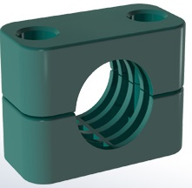
Stauff Clamps For mounting Yagi elements to a horizontal plate attached to a Yagi boom
wilson-company.com/product/30127pp/two-bolt-heavy-duty-clamp-body-only

Slide 51
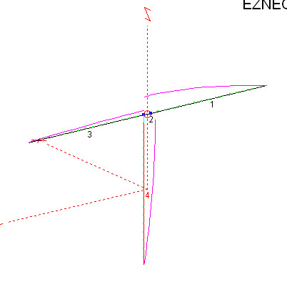
RFI Suppression Choke necessary at the feed point of a Yagi split driven element
Unbalanced driven element current
degrades Yagi sidelobe performance
driven element
driven element
RFI received as common mode current on the outside of the coaxial cable shield degrades
Yagi sidelobes and
front-to-rear performance
innovantennas.com/en/baluns-why-do-i-need-one.html
www.ifwtech.co.uk/g3sek/in-prac/inpr1005_ext_v2.pdf

Slide 52
RFI Suppression Choke Coiled RG-213 Resonant Choke suitable for quiet RFI environments
Close wound
Space the choke a few inches from the boom
to preserve RFI suppression performance
Four turns of RG-213 wound on a 2.5 inch diameter form The builder must measure for choke resonance near 50 MHz

Slide 53
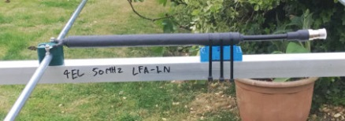
RFI Suppression Choke 20 Mix-31 Round-Cable Ferrite Cores Installed over RG-213 Suitable for most RFI environments
Space the choke a few inches from the boom
to preserve RFI suppression performance
DX Engineering DXE-CB31-500-10 ferrite cores
dxengineering.com/parts/dxe-cb31-500-10
innovantennas.com/index.php?option=com_content&view=article&id=3&Itemid=189&lang=en
myantennas.com/wp/product/cmc-154-3k

Slide 54
RFI Suppression Choke Five Mix-31 Clamp-On Ferrite Beads Optimized for severe RFI environments
K9YC
before installation
audiosystemsgroup.com/ChokesVHF.pdf

Slide 55
Low Loss Coaxial Cable Really pays off on 6 meters
RG-8X flexible coax 40 feet per dB
RG-213 flexible coax 60 feet per dB
LDF4-50A 1/2” hardline 200 feet per dB
3/4” CATV 75 Ω hardline 275 feet per dB
LDF5-50A 7/8” hardline 400 feet per dB
LDF4-50A has one dB less loss than RG-213
at a cable length of only 85 feet
LDF4-50A has two dB less loss than RG-213
at a cable length of only 170 feet
LDF5-50A has one dB less loss than LDF4-50A
at a cable length of 475 feet

Slide 56
Reliable Coaxial Cable Connectors for 6 Meters
N and UHF connectors are commonly used
both have insignificant measured loss on 6 meters
High quality silver plated PL-259 UHF connectors
much more reliable center pin mating force than N connectors
Common N connector failures caused by pin installation errors
unreliable mating caused by insufficient pin length and pin pullback
damage caused by excess pin length and axial pin misalignment
Captive pin N connectors solve N connector reliability issues
assures the necessary +/- 0.020 inch (+/- ½ mm) pin depth tolerance
prevents connector damage caused by pin misalignment
prevents unreliable connection caused by pin pullback
Avoid using adapters as much as possible
use only name-brand silver plated adapters
never use nickel plated or “astro-plated” connectors and adapters
never use cheap import “no name” adapters and connectors
Gently wrench tighten all of your PL-259 connectors (~1/4 turn)
Avoid saving a few dollars on cheap unbranded coaxial cable connectors and adapters

Slide 57
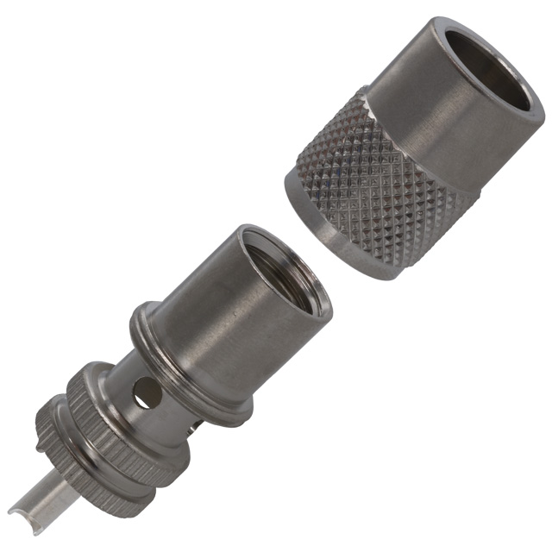
Amphenol 83-1SP PL-259 UHF Male Connector
Shell is labeled exactly:
Amphenol 83-1SP
Silver Plated Center Pin
Silver Plated Body
newark.com/amphenol-rf/83-1sp/rf-coaxial-uhf-plug-straight-50ohm/dp/59K0534
Amphenol 83-1SP: an excellent coaxial connector for 6 meters

Slide 58
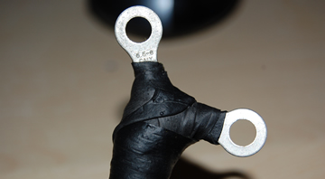
Its Very Easy to Waterproof your RG-213 Coaxial Cable to preserve the life of your coax
Heavy electrical solder lugs
No exposed coax braid, dielectric or center conductor
Scotch 130C rubber tape covered by Scotch 33+ electrical tape
Water and moisture intrusion is the enemy of low coaxial cable loss

Slide 59
Yagi Driven Element Waterproof, shakeproof and corrosion resistant driven element connections
Firmly fasten your coax to the boom to prevent vibration
Heavy electrical solder lugs not in direct contact with aluminum tubing
Stainless steel screw
Stainless steel
nylon insert “Nyloc” locknut
Scotch 130C
rubber tape covered by Scotch 33+ electrical tape
Stainless steel
external tooth lockwasher

Slide 60
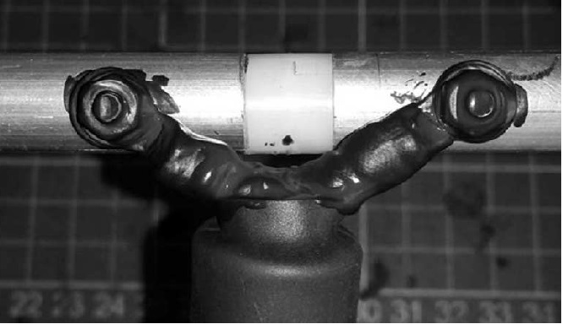
Driven Element Connections Waterproof and Corrosion Resistant
Liquid electrical tape
dxengineering.com/parts/pld-let14z03

Slide 61
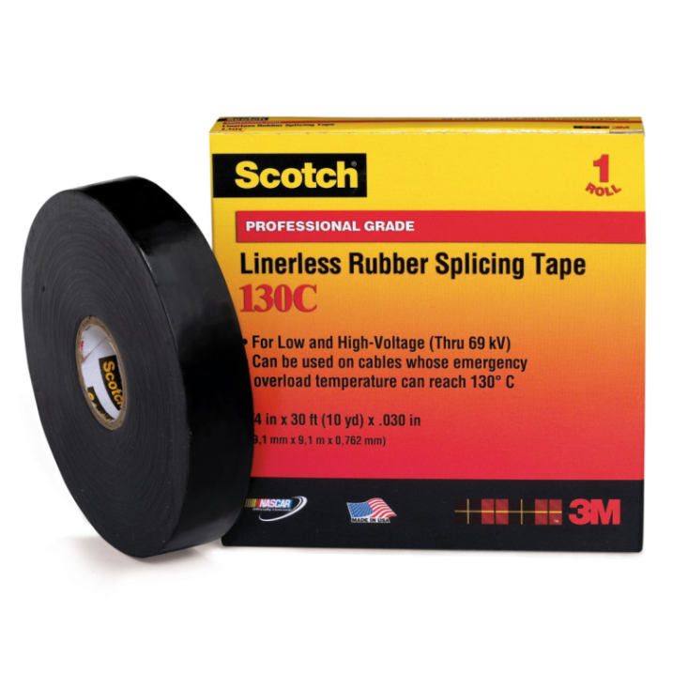
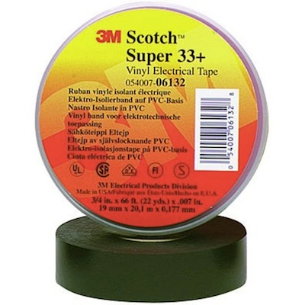
Inexpensive Materials for Waterproofing your Connectors
Cover your connectors with two 50% overlapped layers
of Scotch 130C self-vulcanizing linerless rubber splicing tape
- stretch to 50% of its original width until it changes color
- sticky side facing out
homedepot.com/p/3M-Scotch-3-4-in-x-30-ft-Linerless-Rubber-Splicing-Tape-41717-BX-10/205523418
Cover Scotch 130C rubber tape with two 50% overlapped layers
of Scotch Super 33+ vinyl electrical tape
homedepot.com/p/Scotch-Super-33-3-4-in-x-66-ft-x-0-007-in-Vinyl-Electrical-Tape-Black-6132-BA-10/304653556

